Slide 1

IMPULSE 4.320 CABLE PRODUCT INFORMATION FOCAL INSIDE
February 2022

Slide 2
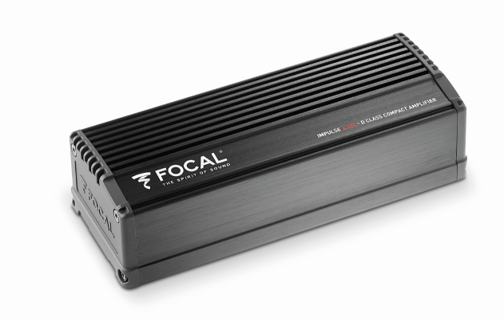
DEDICATED CABLES CONCEPT
Focal has developed a dedicated line of cables for our compact amplifiers, to simplify the installation of audio solutions Focal Inside Plug and play as much as possible.
In an "OEM" philosophy our cables are built in the same materials and connectors as what we develop on our OEM partners.
Our wide range of Focal Inside cables will allow you to respond to all audio configurations.
saving you a lot of time.
Impulse 4.320

Slide 3

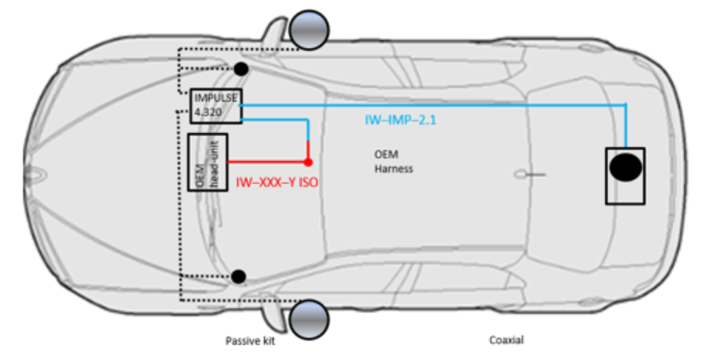
Cables line explication
Cables divided into 3 families:
Iso Harness, Extension Cables for impulse 4.320.
Harness ISO : Made for each brand, to connect to head unit and take audio signal.
Extension cables : to connect ISO Harness to amplifiers.
Take the signal, the booster, and send it to the speakers on doors by the original car cables.
Speakers cables : Power set cable to connect Impulse 4.320 direct to battery.
New Dedicated Tweeter
New Dedicated Connectors
Head unit
Harness Y / ISO
Extension
Cable connection
In / Out
Power cable set

Slide 4
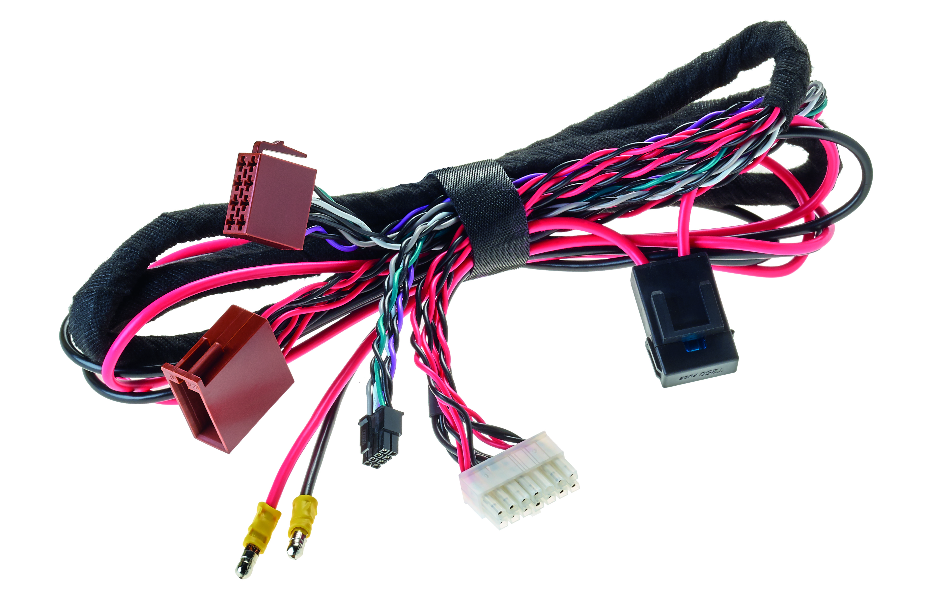
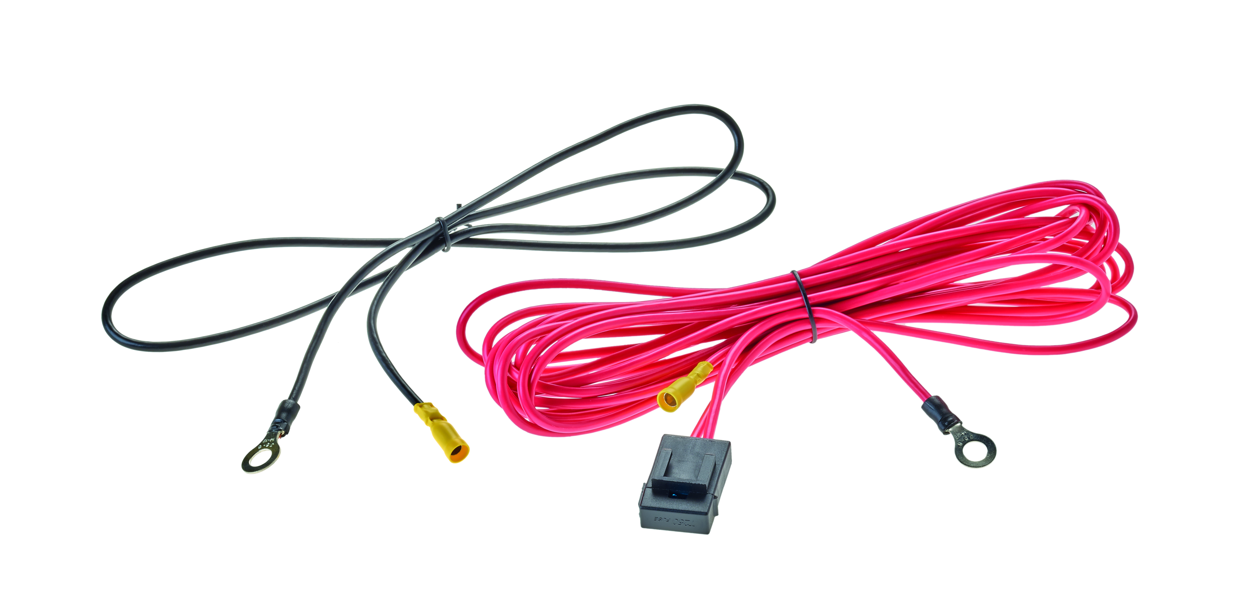
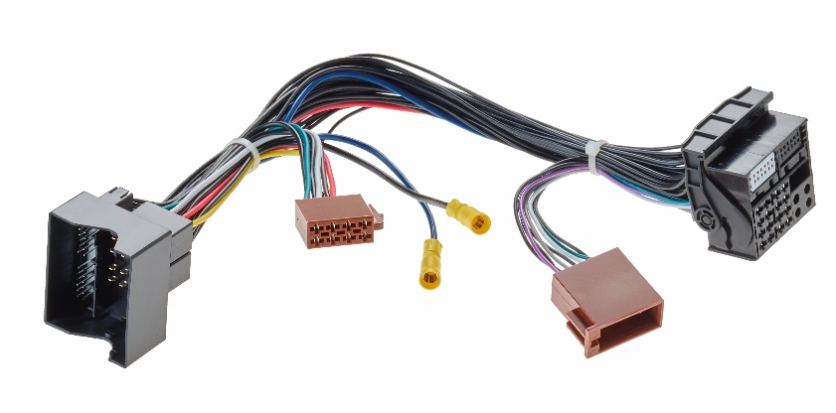
3 Families cables
1/ Power set
2/ harness ISO cable
3/ Extension cable

Slide 5
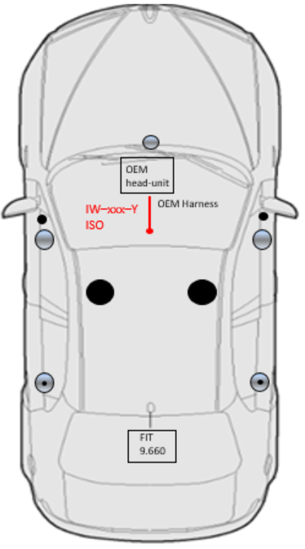
1 / Y ISO HARNESS
IW – XXX – Y – ISO
Y iso Harness, are developed for each car brands, for better and easer installation for perfect integration.
Specific brands connector, and iso connectors speakers.
Possibility to connect Impulse 4.320 power supply directly with this bracket.
Made for many brands
Can be used for the following products:
Impulse 4.320, and also Ibus 2.0/2.1
Input speakers
Output speakers
OEM brands connector
Power supply for
Impulse 4.320

Slide 6




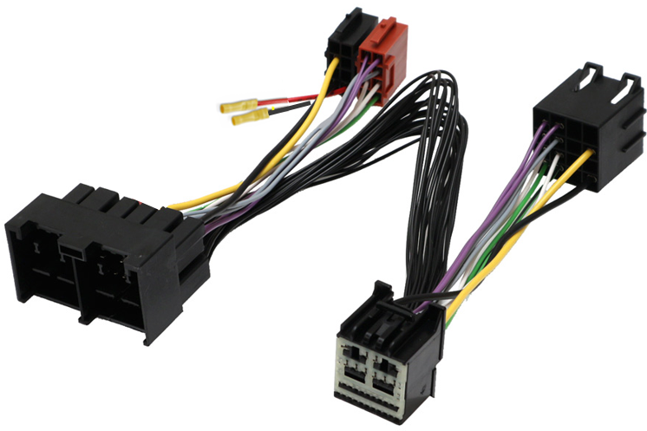
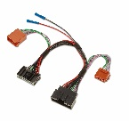
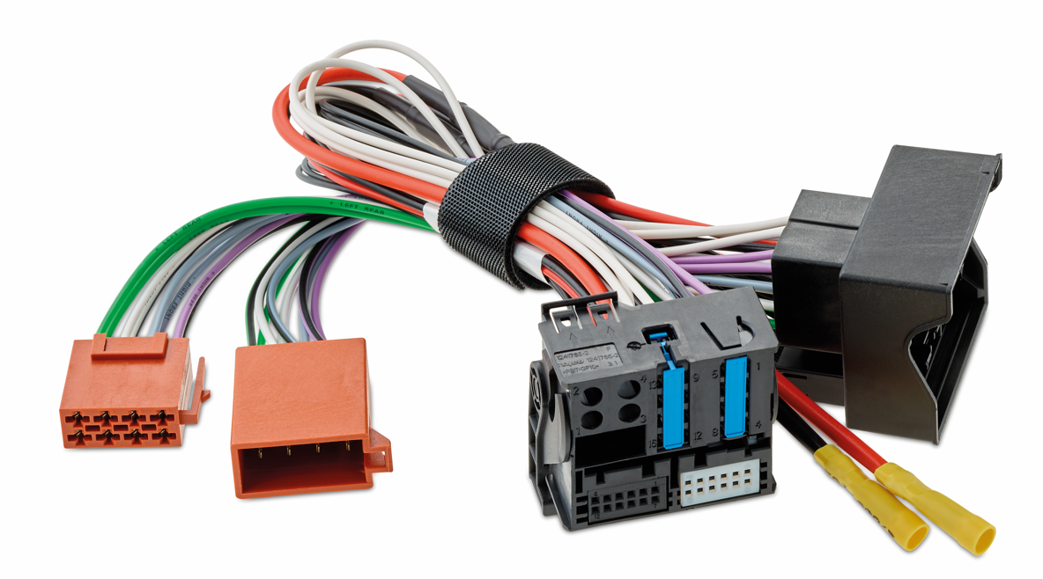
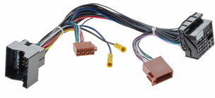





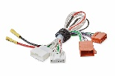
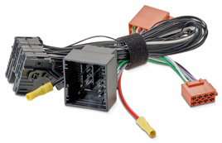
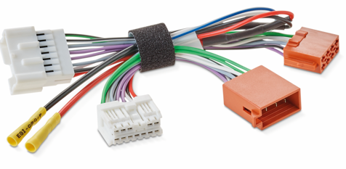


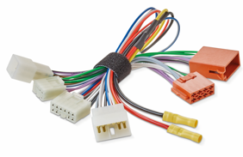
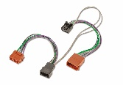
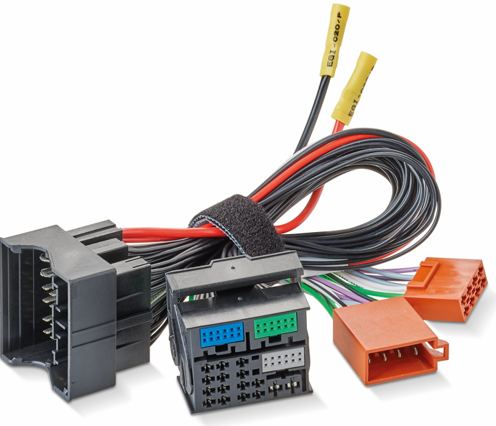
1 / Y ISO HARNESS details
IW – XXX – Y – ISO
Y iso Harness, are developed for each car brands, for better and easer installation for perfect integration.
Specific brands connector, and iso connectors speakers.
Possibility to connect Impulse 4.320 power supply directly with this bracket.
Made for:
Ford, BMW/Mini, Toyota, Nissan
Renault, Peugeot/Citroen, VW
Can be used for the following products:
Impulse 4.320, Fit 9.660, Ibus 2.0/2.1
IW FOR YISO HARNESS
IW FOR YISO HARNESS
IW FOR YISO HARNESS V2
IW MBZ YISO HARNESS
IW NIS YISO HARNESS
IW PSA YISO HARNESS
IW REN YISO HARNESS
IW TOY YISO HARNESS
IW TOY YISO HARNESS V2
IW VW YISO HARNESS

Slide 7

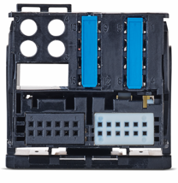
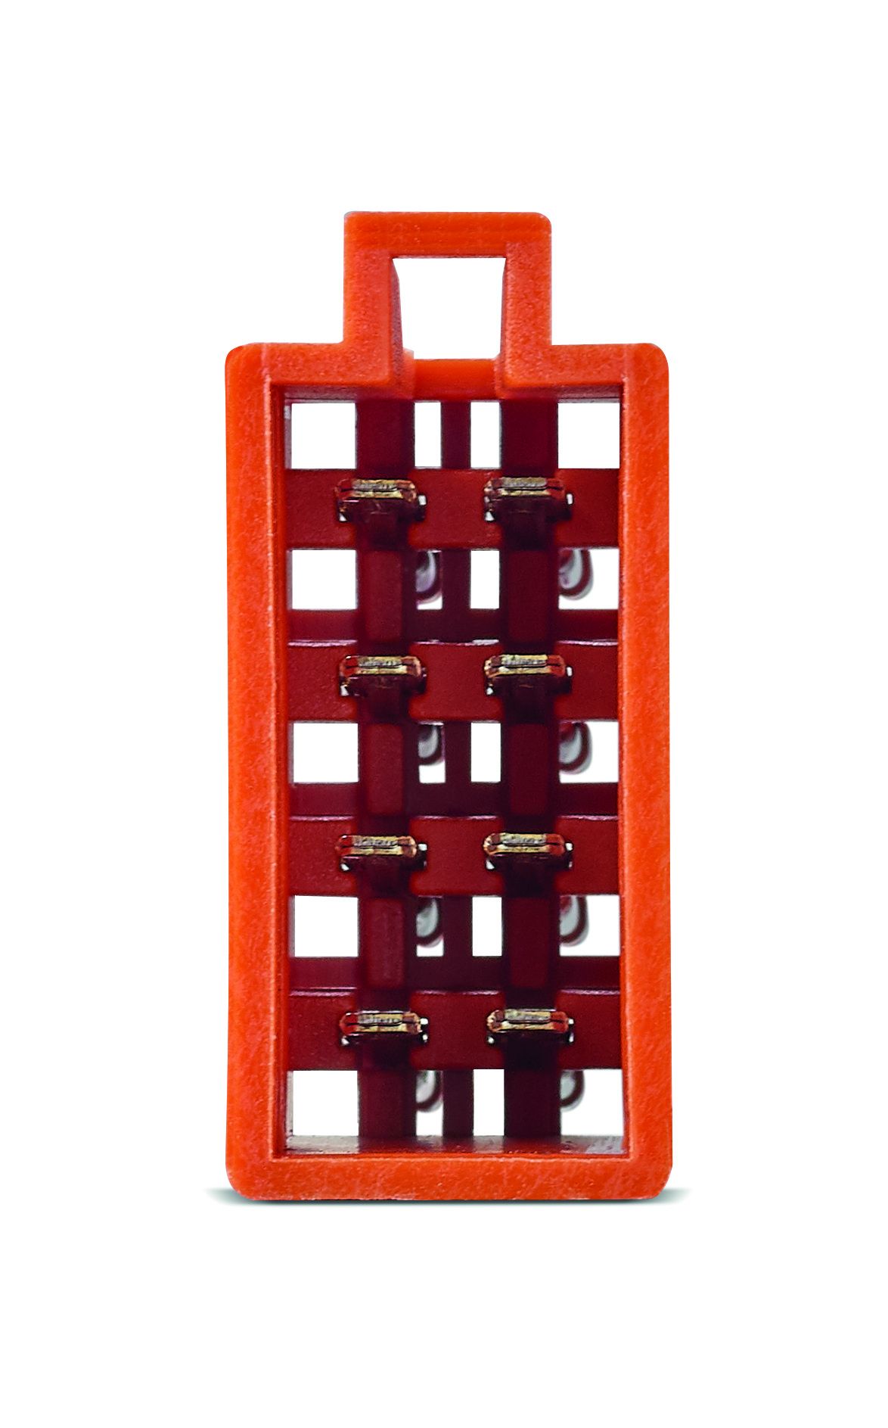
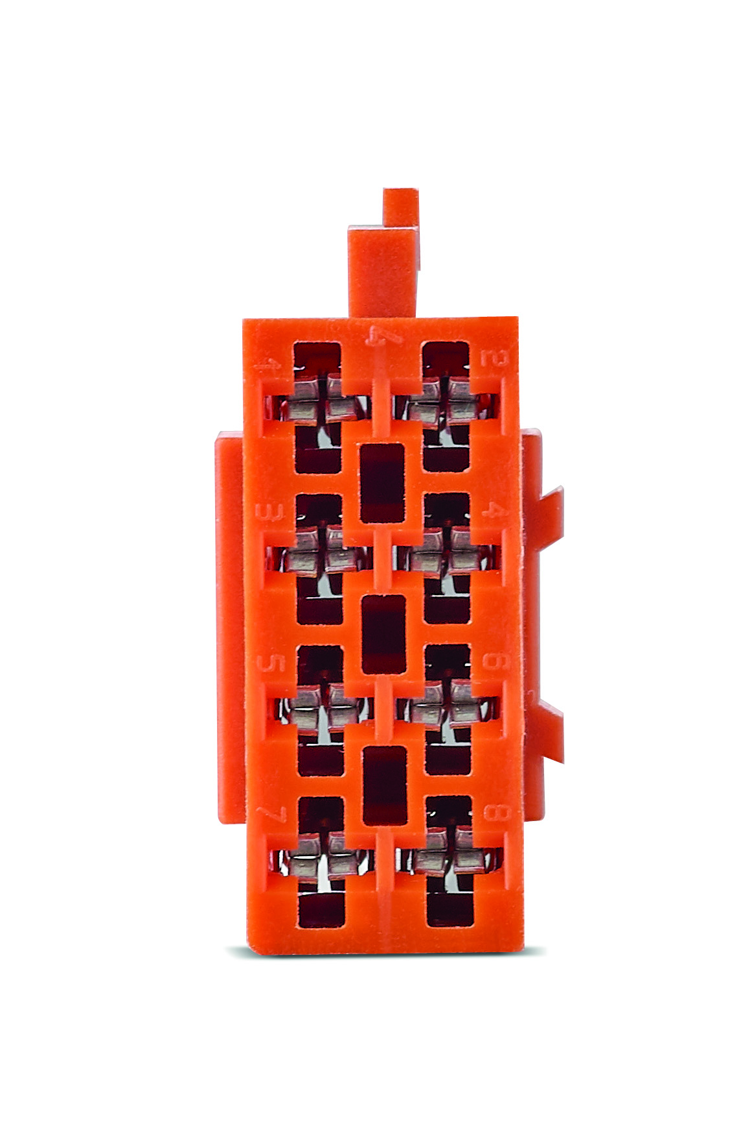
IW-BMW-Y-ISO-HARNESS
Specific
BMW and Mini harness
Head Unit connector
Iso Connectors

Slide 8
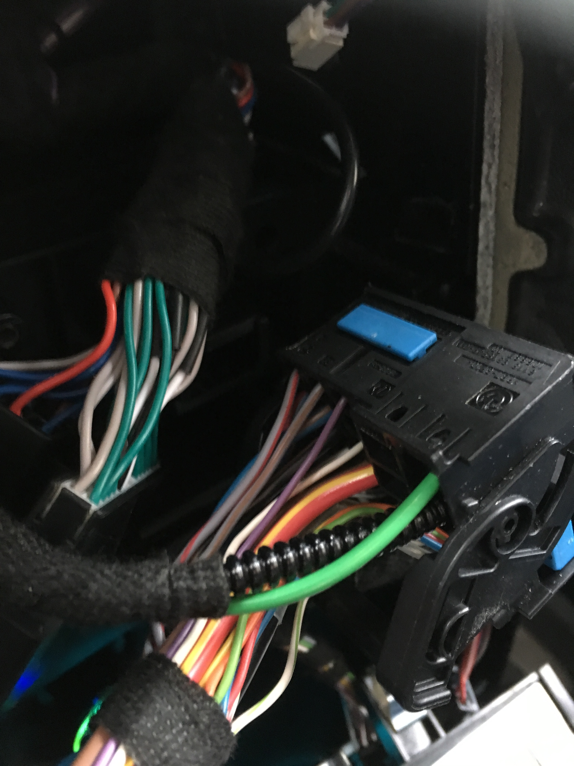
IW-BMW-Y-ISO-HARNESS
Serie 1, 2, 3, 4, 5, 6, 7
i3 / i8 / Z4
Serie X1, X2, X3, X4, X5, X6, X7
Countryman, Clubman, Cabrio, Roadster, Convertible, Paceman
Find application cable in car compatibility sheet
Harness Iso cable not compatible with OEM amplifier

Slide 9
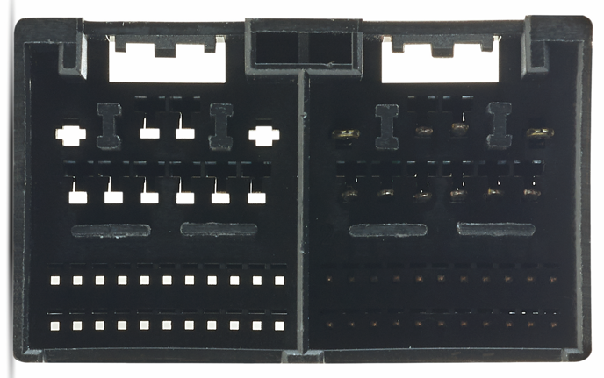
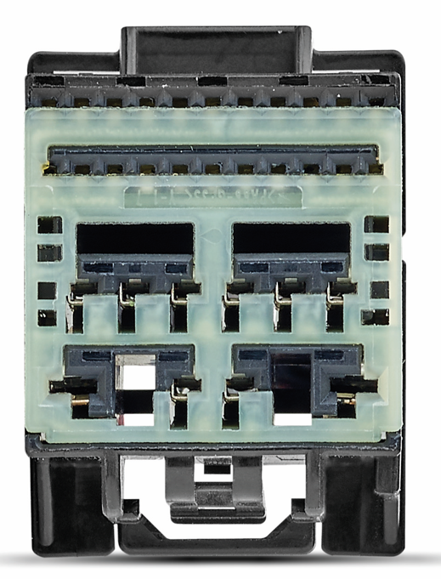
IW-FORD-Y-ISO-HARNESS
2 différent models
Specific
FORD harness
Head Unit connector
Iso Connectors

Slide 10
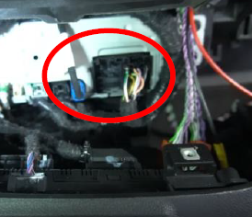
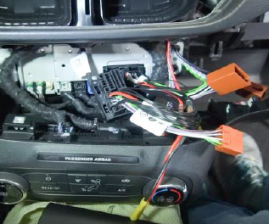
IW-FORD-Y-ISO-HARNESS
2 différent models
Bronco
F-150 2021-
Fiesta VIII
Focus IV
Kuga III
Puma II
Sharp
Tourneo Connect 2019-
Tourneo Custom 2019-
Transit Connect
Transit Courier
Transit Custom
Find application cable in car compatibility sheet
Harness Iso cable not compatible with OEM amplifier

Slide 11
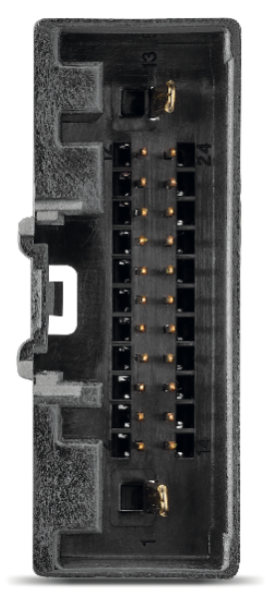
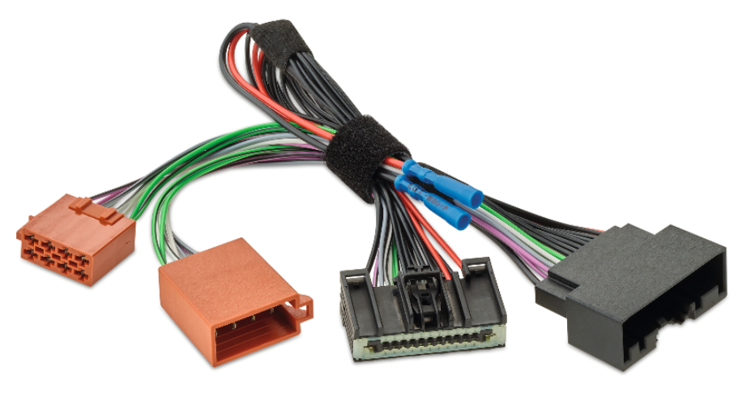
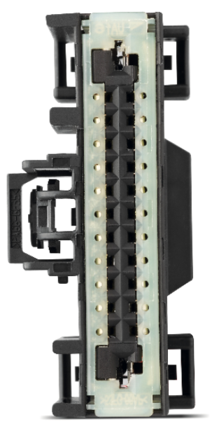
IW-FORD-Y-ISO-HARNESS V2
2 différent models
Specific
FORD V2 harness
Head Unit connector
Iso Connectors

Slide 12
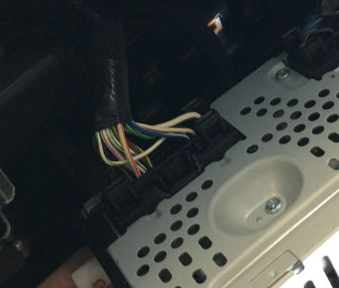
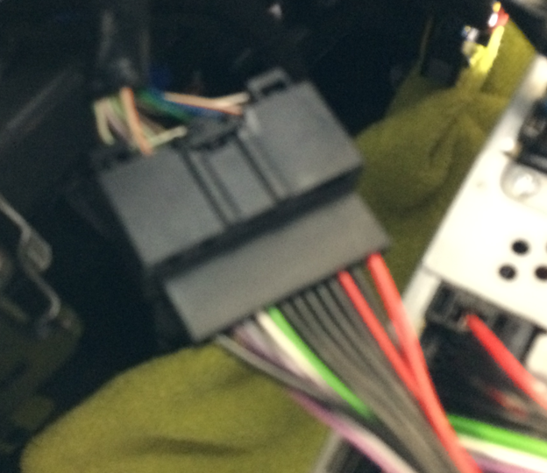
IW-FORD-Y-ISO-HARNESS V2
2 différent models
F-150
D-max
C-max
Ecosport
Edge II
Fiesta VII
Focus III
Galaxis III
Ka+
Kuga II
Mondeo
Mustang -2020
Ranger III
S-max II
Tourneo Connect -2018
Tourneo Courrier -2018
Tourneo Custom -2018
Transit connect -2018
Transit custom -2018
Find application cable in car compatibility sheet
Harness Iso cable not compatible with OEM amplifier

Slide 13
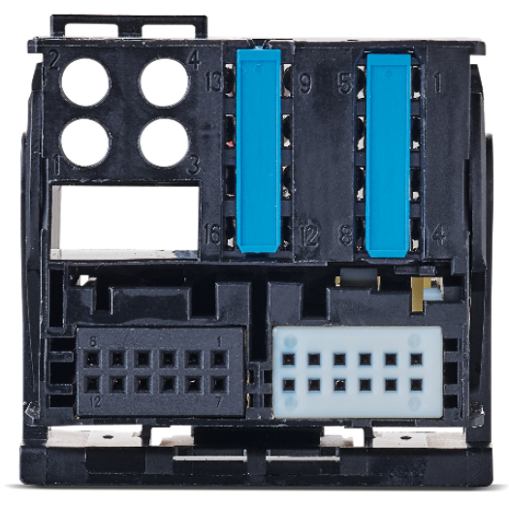
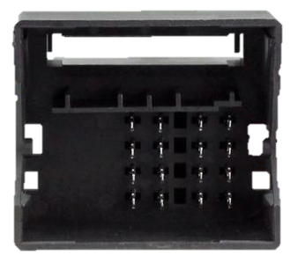
IW-MBZ-Y-ISO-HARNESS
Specific
Mercedes harness
Head Unit connector
Iso Connectors

Slide 14
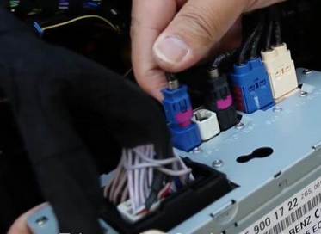
IW-MBZ-Y-ISO-HARNESS
Before 06-2020 USE WITH NGT5 head unit
C class
E class
S class
Glc
Glc coupe
Find application cable in car compatibility sheet
Harness Iso cable not compatible with OEM amplifier

Slide 15
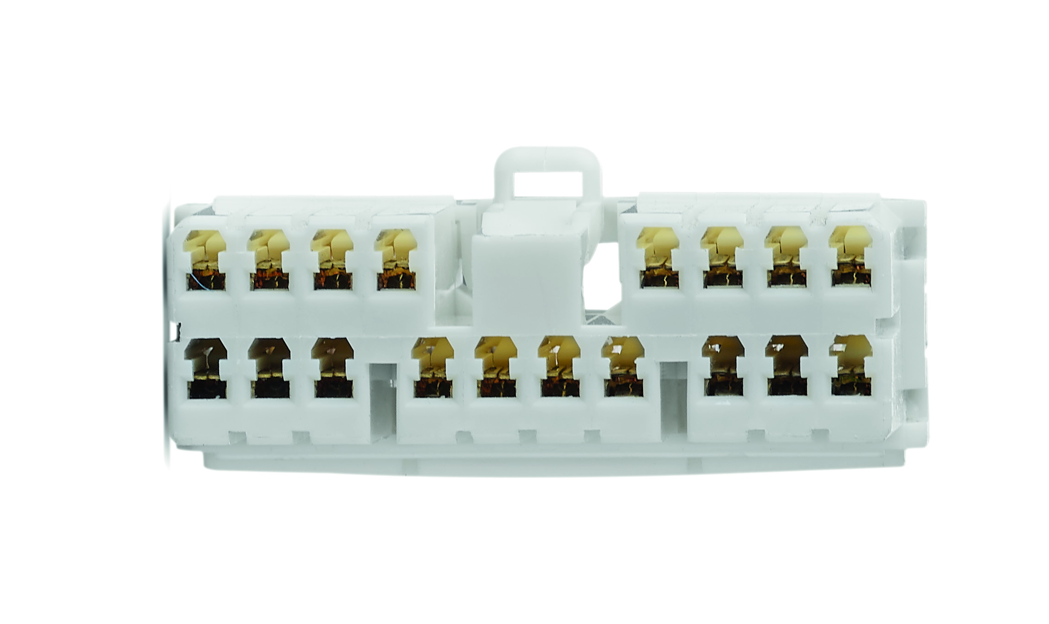
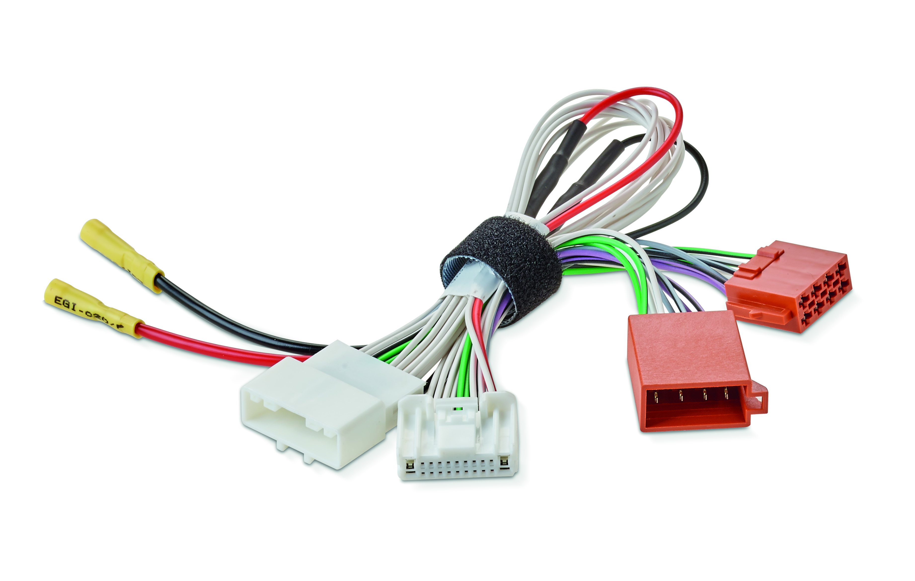
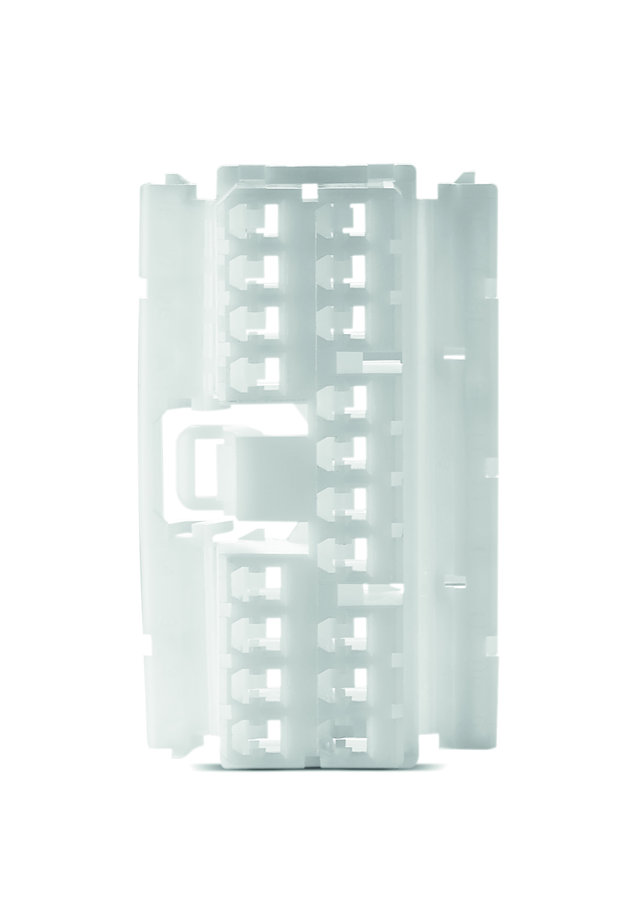
IW-NIS-Y-ISO-HARNESS
Specific
NISSAN harness
Head Unit connector
Iso Connectors

Slide 16
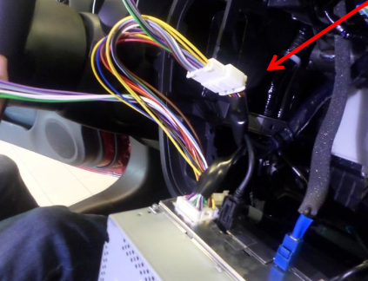
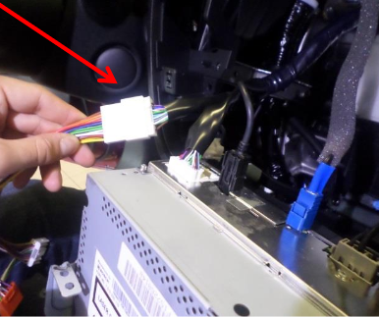
IW-NIS-Y-ISO-HARNESS
Note
Nv 300
Nv 400
Pathfinder
Pulsar
Tiida
Vera
X-trail
X-terra
Urvan
350 Z
370 Z
Altima
Armada
Frontier
Gt-R
Juke
Micra
Murano
Find application cable in car compatibility sheet
Harness Iso cable not compatible with OEM amplifier

Slide 17
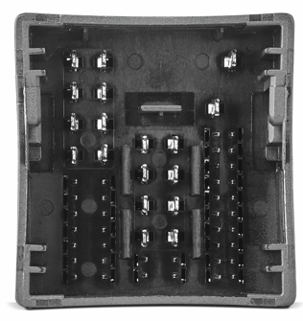
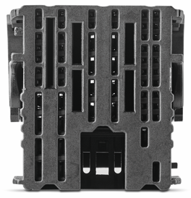
IW-PSA-Y-ISO-HARNESS
Specific
PEUGEOT/ CITROEN harness
Head Unit connector
Iso Connectors

Slide 18
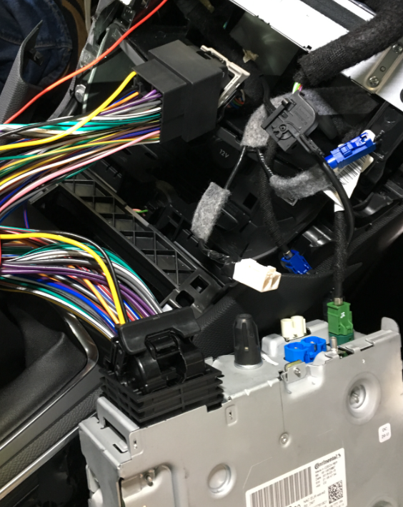
IW-PSA-Y-ISO-HARNESS
208 II
308 II
508 II
2008
3008
5008
Expert III
Rifter
Traveler III
Berlingo III
C3 III
C4 grand space Tourer
C4 II
C4 cactus II
C4 space Tourer
C5 aircross
Jumpy III
Space Tourer
Find application cable in car compatibility sheet
Harness Iso cable not compatible with OEM amplifier

Slide 19

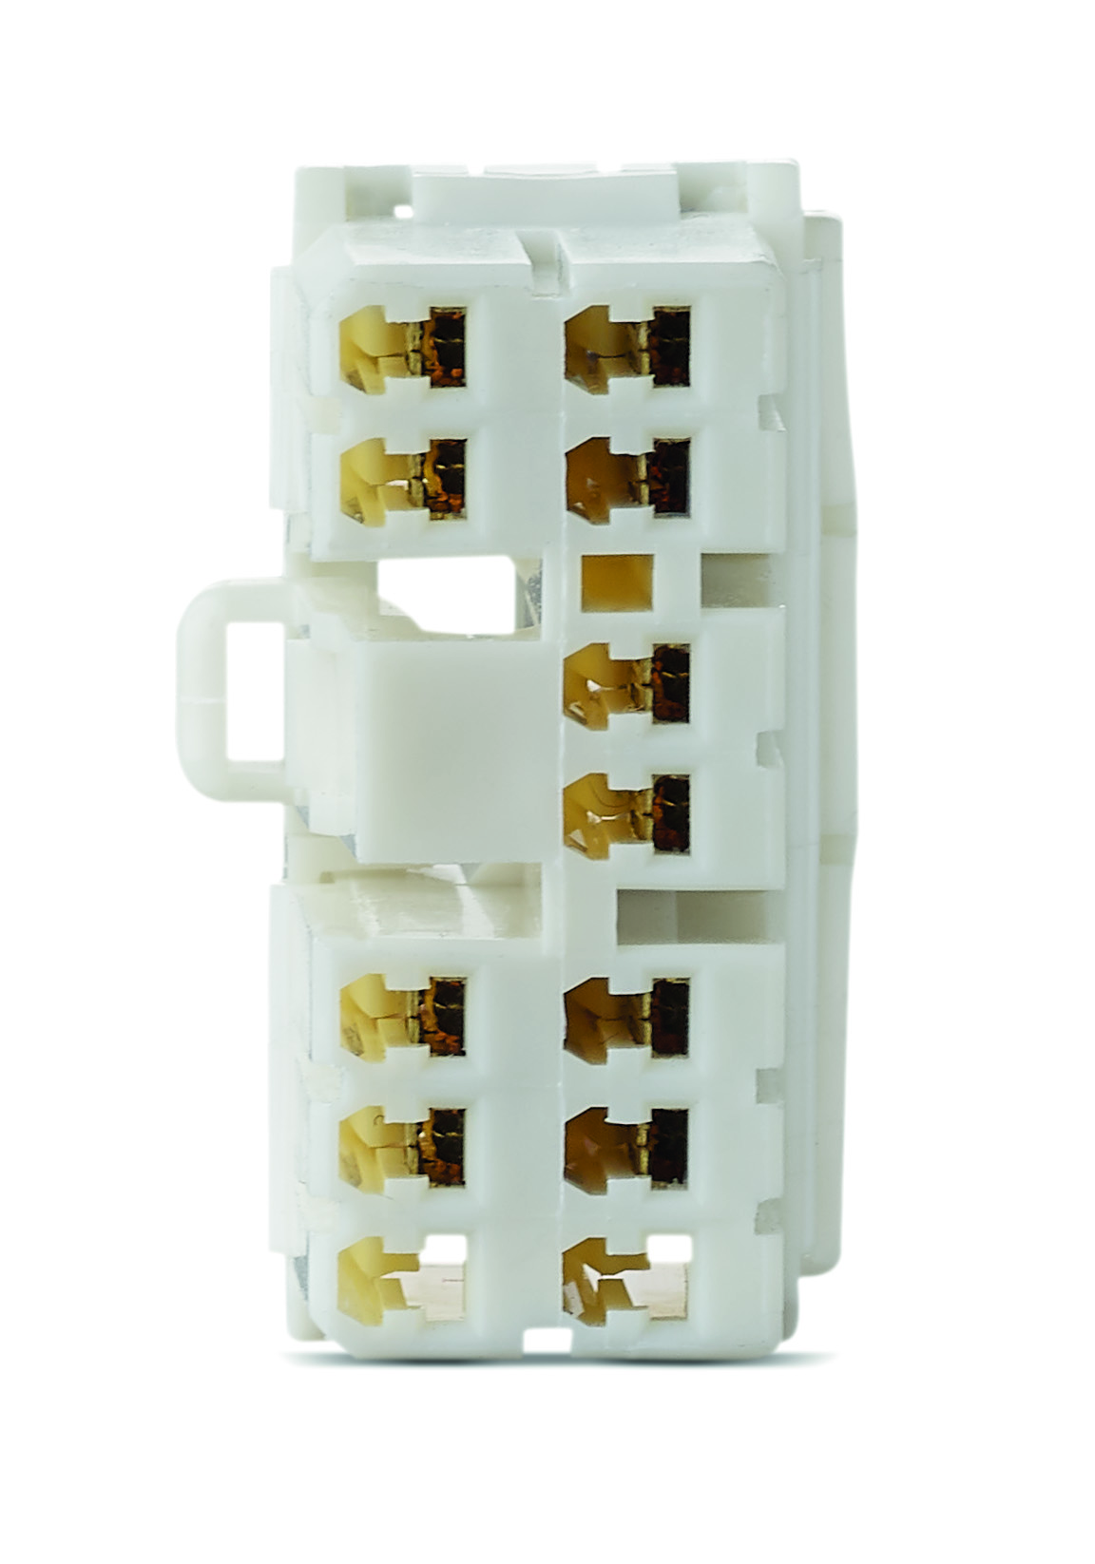
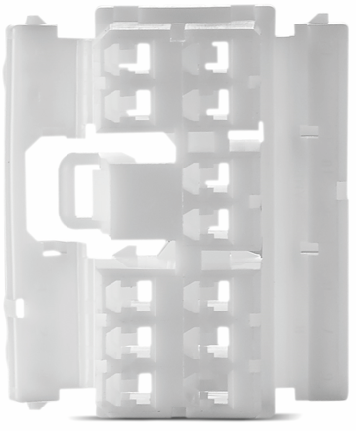
IW-REN-Y-ISO-HARNESS
Specific
RENAULT harness
Head Unit connector
Iso Connectors

Slide 20
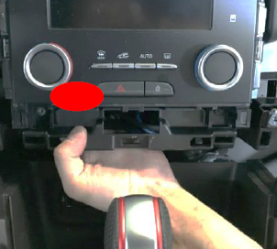
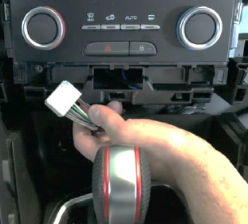
IW-REN-Y-ISO-HARNESS
Alaskan
Clio
Captur
Espace
Laguna
Megane
Scenic
Twingo II/III
Vel satis
Wind
Zoe
Dokker
Duster
Lodgy
Logan
Sandero
For two
For two cabrio
For two brabus
For four
Find application cable in car compatibility sheet
Harness Iso cable not compatible with OEM amplifier

Slide 21


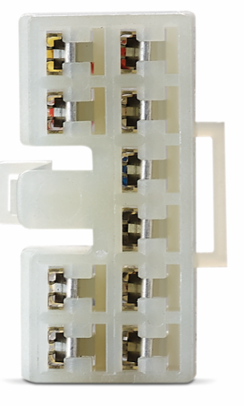
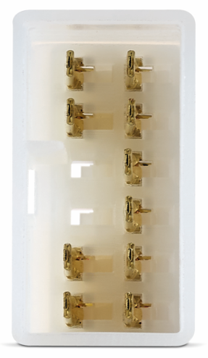
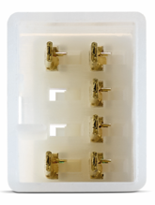
IW-TOY-Y-ISO-HARNESS
Specific
TOYOTA harness
Head Unit connector
Iso Connectors

Slide 22
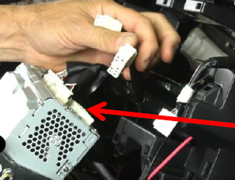
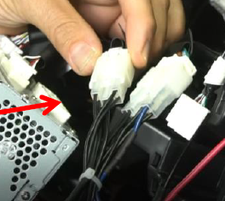
IW-TOY-Y-ISO-HARNESS
4 Runner
Altis
Auris
Avalon
Avanza
C-Hr
Camry II
Celica
Echo
Fj cruiser
Fortuner
Gt 86
Highlander
Hilux
IQ
Land cruiser
Matrix
Prius
Pro ace
Rav 4
……
Ct
Gx
IS
Ls
BRZ
Forester IV
Impreza IV
Outback IV
Outback V
Wrx
Find application cable in car compatibility sheet
Harness Iso cable not compatible with OEM amplifier

Slide 23
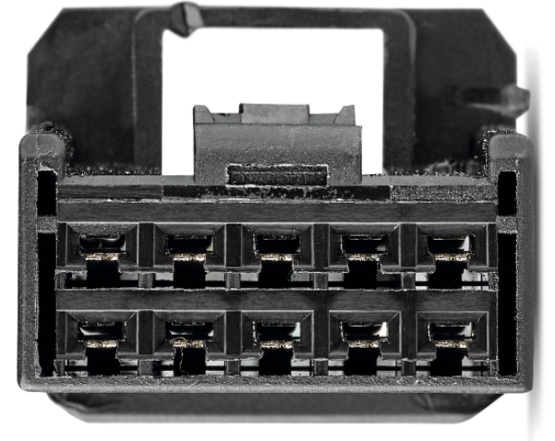


IW-TOY-Y-ISO-HARNESS V2
2 différent models
Specific
TOYOTA V2 harness
Head Unit connector
Iso Connectors

Slide 24
IW-TOY-Y-ISO-HARNESS V2
2 différent models
4 Runner 2020-
Avalon 2019-
C-Hr 2019-
Camry II 2018-
Corolla 2019-
Highlander 2020-
Rav 4 2019-
Sequoia 2019-
Sienna 2018-
Tacoma 2019-
Tundra 2020-
……
……
Find application cable in car compatibility sheet
Harness Iso cable not compatible with OEM amplifier

Slide 25


IW-VW-Y-ISO-HARNESS
Specific
VW harness
Head Unit connector
Iso Connectors

Slide 26

IW-VW-Y-ISO-HARNESS
Golf 7
Polo
Passat
New beetle
Tiguan
…
Find application cable in car compatibility sheet
Harness Iso cable not compatible with OEM amplifier

Slide 27
FOCAL INSIDE ELECTRONIC
IMPULSE 4.320 cables system

Slide 28

FRONT and REAR SPEAKERS
All brands configuration
Audio: Front and Rear speakers power by Impulse
4x50 W rms
Amplifier : Impulse 4.320
Speakers : Component front
Coaxial rear
Cables :
Head unit harness IW xxx Y ISO HARNESS
Extension cables IW IMP EXT 150
Power cable optional IW PWSUP 600

Slide 29


EXTENSION CABLE 4.0 IW IMP EXT 150
IW – IMP – EXT – 150
Extension cables IMPULSE 4.320
Connect the head-unit harness with ISO connector, in Amplifier IMPULSE 4.320 with specific connectors.
With the iso connector we recover the signal at the iso output of the car head unit, and after amplifying it we send it back to the front and rear doors speakers, using the original car harness.
This cable simply the impulse connection in each car. The IMPULSE 4.320 amplifier allows you to amplify the front speakers and rear speakers with its 4 channels.
4x50 Wrms for front and rear speakers
If the power supply allows you to directly connect the impulse to the dedicated connectors of the Focal Y ISO harness. The search for position and ground power is then completely simplified.
Fuse protection
OEM cable protection
Output speakers
to impulse
Iso connector
Direct plug to Focal Y ISO harness
Input speakers to impulse
Power supply
connection

Slide 30


Cable explication
IW IMP EXT 150
It is very easy to upgrade the sound of your car, from the original car radio.
Have installed a cable behind the car radio on the original connectors.
Our Y ISO Harness adaptor sends the audio signal to our dedicated cable of the chosen audio solution.
Direct plug play on the Impulse 4.320 amplifier and amplify front and rear speakers.
it remains to connect a Ground and the power supply and the installation is ready.
Choice the harness référence on Focal Inside compatibility list
Focal Head unit
Harness solution
Y iso cables

Slide 31



IW-IMP-EXT-150
Impulse cable 1,5mt long
ISO connector
Power supplier connection

Slide 32


Slide 33

FRONT and ONE SUBWOOFER
All brands configuration
Audio: Front and Rear subwoofer power by Impulse
2x50 + 1 x 160 W rms
Amplifier : Impulse 4.320
Speakers : Component front
PSB200 subenclosure
Coaxial rear (power by head-unit)
Cables :
Head unit harness IW xxx Y ISO HARNESS
Extension cables IW IMP 2.1
Power cable optional IW PWSUP 600

Slide 34


EXTENSION CABLE IW IMP 2.1
IW – IMP – 2.1
Extension cables IMPULSE 4.320
Connect the head-unit harness with ISO connector, in Amplifier IMPULSE 4.320 with specific connectors.
With the iso connector we recover the signal at the iso output of the car head unit, and after amplifying it we send it back to the front speakers using the original car harness. 2 rear channel Impulse are bridge to mono for manage subwoofer box, PSB 200.
This cable simply the impulse connection in each car. The IMPULSE 4.320 amplifier allows you to amplify the front speakers and subwoofer box with its 3 channels.
2x50w front 1 x160w rms bridge subwoofers.
If the power supply allows you to directly connect the impulse to the dedicated connectors of the Focal Y ISO harness. The search for position and ground power is then completely simplified.
OEM cable protection
Fuse protection
Power supply
connection
Subwoofer cable to connect
PSB 200
Input speakers to impulse
Output speakers to impulse direct iso car Harness

Slide 35


Cable explication
IW IMP 2.1
It is very easy to upgrade the sound of your car, from the original car radio.
Have installed a cable behind the car radio on the original connectors.
Our Y ISO Harness adaptor sends the audio signal to our dedicated cable of the chosen audio solution.
Direct plug play on the Impulse 4.320 amplifier and on sub boxes PSB200.
Direct bridge subwoofer mode.
it remains to connect a Ground and the power supply and the installation is ready.
Choice the harness référence on Focal Inside compatibility list
Focal Head unit
Harness solution
Y iso cables

Slide 36







Full pack: Speakers replacement with IMPULSE amplifier and PSB 200
+
+
+
+
DEDICATED INTEGRATION CABLES
Y ISO HARNESS
Choice your Brand cable
IW IMP 2.1 HARNESS
Front and 1 subwoofer
IMPULSE 4.320
Speakers replacement
Choice your brand speakers
PSB 200
Rear speakers on head unit

Slide 37

FRONT and TWO SUBWOOFERS
All brands configuration
Audio: Front and i sub twin power by Impulse
2x50 + 2 x80 W rms (2 ohms subwoofers)
Amplifier : Impulse 4.320
Speakers : Component front
ISUB TWIN subwoofers 2 ohms
Coaxial rear (power by head-unit)
Cables :
Head unit harness IW xxx Y ISO HARNESS
Extension cables IW IMP 2.2
Power cable optional IW PWSUP 600

Slide 38



EXTENSION CABLE IW IMP 2.2
IW – IMP – 2.2
Extension cables IMPULSE 4.320
Connect the head-unit harness with ISO connector, in Amplifier IMPULSE 4.320 with specific connectors.
With the iso connector we recover the signal at the iso output of the car head unit, and after amplifying it we send it back to the front speakers using the original car harness. 2 rear channel Impulse can manage 2 front subwoofers, better with 2ohms speakers.
This cable simply the impulse connection in each car. The IMPULSE 4.320 amplifier allows you to amplify the front speakers and front subwoofers
2x50w front 2 x80w rms 2ohms subwoofers.
If the power supply allows you to directly connect the impulse to the dedicated connectors of the Focal Y ISO harness. The search for position and ground power is then completely simplified.
2 x Subwoofer cable to connect
2 front subwoofers
Fuse protection
OEM cable protection
Input speakers
to impulse
Ground supply
connection
Output speakers to impulse direct iso car Harness

Slide 39


Cable explication
IW IMP 2.2
It is very easy to upgrade the sound of your car, from the original car radio.
Have installed a cable behind the car radio on the original connectors.
our Y ISO Harness adaptor sends the audio signal to our dedicated cable of the chosen audio solution.
Direct plug play on the Impulse 4.320 amplifier and on the two twin sub boxes with IW IMP 2.2 cable.
it remains to connect a Ground and the power supply and the installation is ready.
Choice the harness référence on Focal Inside compatibility list
Focal Head unit
Harness solution
Y iso cables

Slide 40


Slide 41
MERCEDES FRONT and TWO SUBWOOFERS
Configuration with NGT5
Audio: Front and isub MBZ 2 power by Impulse
2x50 + 2 x80 W rms (2 ohms subwoofers)
Amplifier : Impulse 4.320
Speakers : Component front
ISUB MBZ 2 subwoofers 2 ohms
Coaxial rear (power by head-unit)
Cables :
Head unit harness IW MBZ Y ISO HARNESS
Extension cables IW IMP 2.2
Power cable optional IW PWSUP 600

Slide 42
EXTENSION CABLE IW IMP 2.2
IW – IMP – 2.2
Extension cables IMPULSE 4.320
Connect the head-unit harness with ISO connector, in Amplifier IMPULSE 4.320 with specific connectors.
With the iso connector we recover the signal at the iso output of the car head unit, and after amplifying it we send it back to the front speakers using the original car harness. 2 rear channel Impulse can manage 2 front subwoofers, better with 2ohms speakers.
This cable simply the impulse connection in each car. The IMPULSE 4.320 amplifier allows you to amplify the front speakers and front subwoofers
2x50w front 2 x80w rms 2ohms subwoofers.
If the power supply allows you to directly connect the impulse to the dedicated connectors of the Focal Y ISO harness. The search for position and ground power is then completely simplified.
2 x Subwoofer cable to connect
2 front subwoofers
Fuse protection
OEM cable protection
Input speakers
to impulse
Ground supply
connection
Output speakers to impulse direct iso car Harness

Slide 43

Cable explication
IW IMP 2.2
Control the harness référence on Focal Inside compatibility List, Word Only with NGT5 Mercedes head unit, before 06/2019
It is very easy to upgrade the sound of your car, from the original car radio.
Have installed a cable behind the car radio on the original connectors.
our Y ISO Harness adaptor sends the audio signal to our dedicated cable of the chosen audio solution.
Direct plug play on the Impulse 4.320 amplifier and on the two twin sub boxes with IW IMP 2.2 cable.
it remains to connect a Ground and the power supply and the installation is ready.
Focal Head unit
Harness solution
Y iso cables

Slide 44


Mercedes Warning
IW MBZ Y ISO
HARNESS

Slide 45


Slide 46
BMW FRONT and TWO SUBWOOFERS
Audio: front and rear speakers power by Impulse
2x 50w + 2x 80w rms (2 ohms)
Amplifier : Impulse 4.320
Speakers : Component front
Front BMW subwoofers 2ohms
Coaxial rear (power by head-unit)
Cables :
Extension cables IW BMW IMP 2.1
Power cable optional IW PWSUP 600

Slide 47



2 / EXTENSION CABLE IMPULSE 4.320
IW – BMW - IMP – 2.1
Extension cables IMPULSE 4.320
This BMW 2.1 cable for the impulse uses a specific connection. it takes the car radio signal directly from the subwoofers connector under the front seats.
This signal is sent in the impulse and manage to amplify the front speakers of the car, and the both subwoofers under the seats.
All adjustments, crossover, levels, phase, are made in the Impulse 4.320.
No need to dismantle the car radios of bmw, this type of assembly saves a lot of installation time,
it's simple and very effective, the performances are really amasing with a simply never seen.
2 plugs for power supply use IW POW SUP 600
OEM cable protection
Power supply
connection
Input speakers to impulse
Output speakers to impulse direct to bmw subwoofers

Slide 48



Cable explication
IW BMW IMP 2.1
On standard BMW audio versions, the audio signal from the front doors is parallel to the front subwoofers.
The audio signal coming out of the car radio goes through the subwoofers under the seats to go into the doors.
Our IW BMW IMP 2.1 focal cable allows to recover the signal on this BMW sub connectors, left and right.
Direct to amplify it with our impulse 4.320.
to separate it, 2 channels for the front doors, and two channels for the two subwoofers left and right.
With the settings of the impulse, this will give you an extraordinary update, and simply without disassembling the car radio.
This cable is compatible with cars with 4 wires in the subwoofer connectors under the seats.

Slide 49



IW BMW IMP 2.1
Signal take under
front seat
OEM BMW connector adapter
Compact size amplifier

Slide 50



Slide 51


4 / POWER SUPPLIER
IW – PW – SUP 600
Power Supplier pack
Fit 9.660/ Impulse 4.320
Complet pack for power alimentation and ground connection.
Use by Fit 9.660 and Impulse 4.320.
6mt cable red alimentation.
1mt cable black ground.
2 yellow plug connexion.
Fuse protection.
Fuse protection
6mt cable alimentation
Complet pack power supplier
Yellow plug for easy installation
1mt ground cable

Slide 52


4 / SIMULATOR SPEAKERS CABLE
IW – SPKSIM – ISO speakers
Speakers simulator Impulse 4.320
Some models of cars, when we change the original speakers, and adding an amplifier, it happens that it brings some problems. like losing the front / rear fader.
To solve this type of problem, we have developed a speaker simulator with audio resistance.
this cable easily plugs into the ISO connectors of our harness speakers. and remove audio faults.
simple and efficient
Can be use to Impulse 4.320, and Ibus 2.0/2.1
Audio focal
resistances
1 cables by box
ISO output connector
ISO input connector

Slide 53

CABLE LIST

