Slide 1
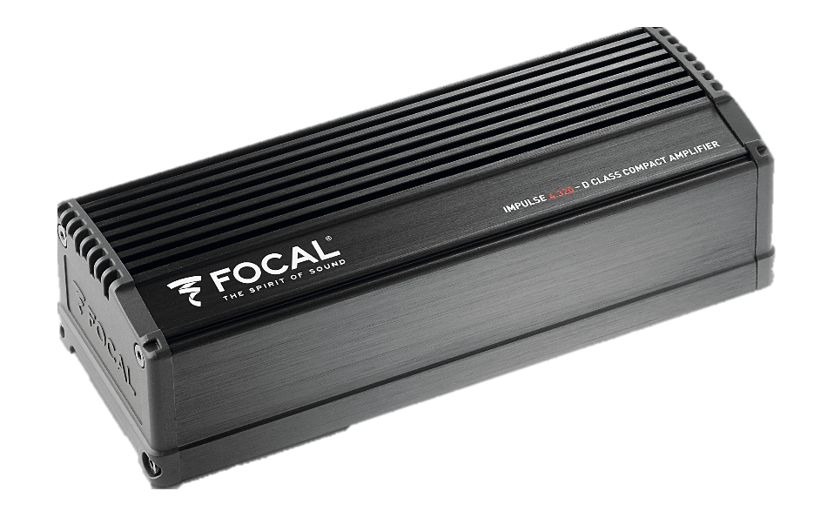
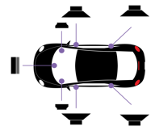
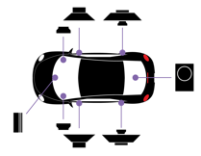
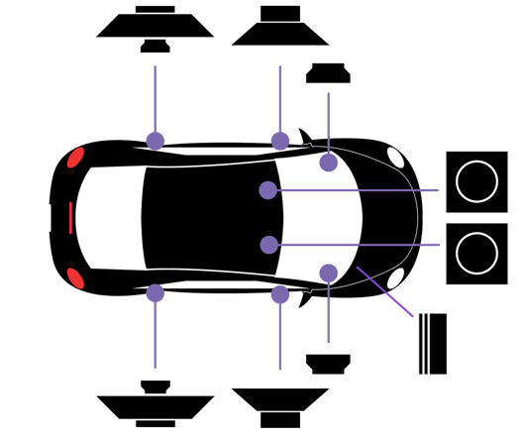
Impulse 4.320 SET UP
Front + Rear solution
Front + PSB 200 solution
Front + ISUB Twin solution

Slide 2
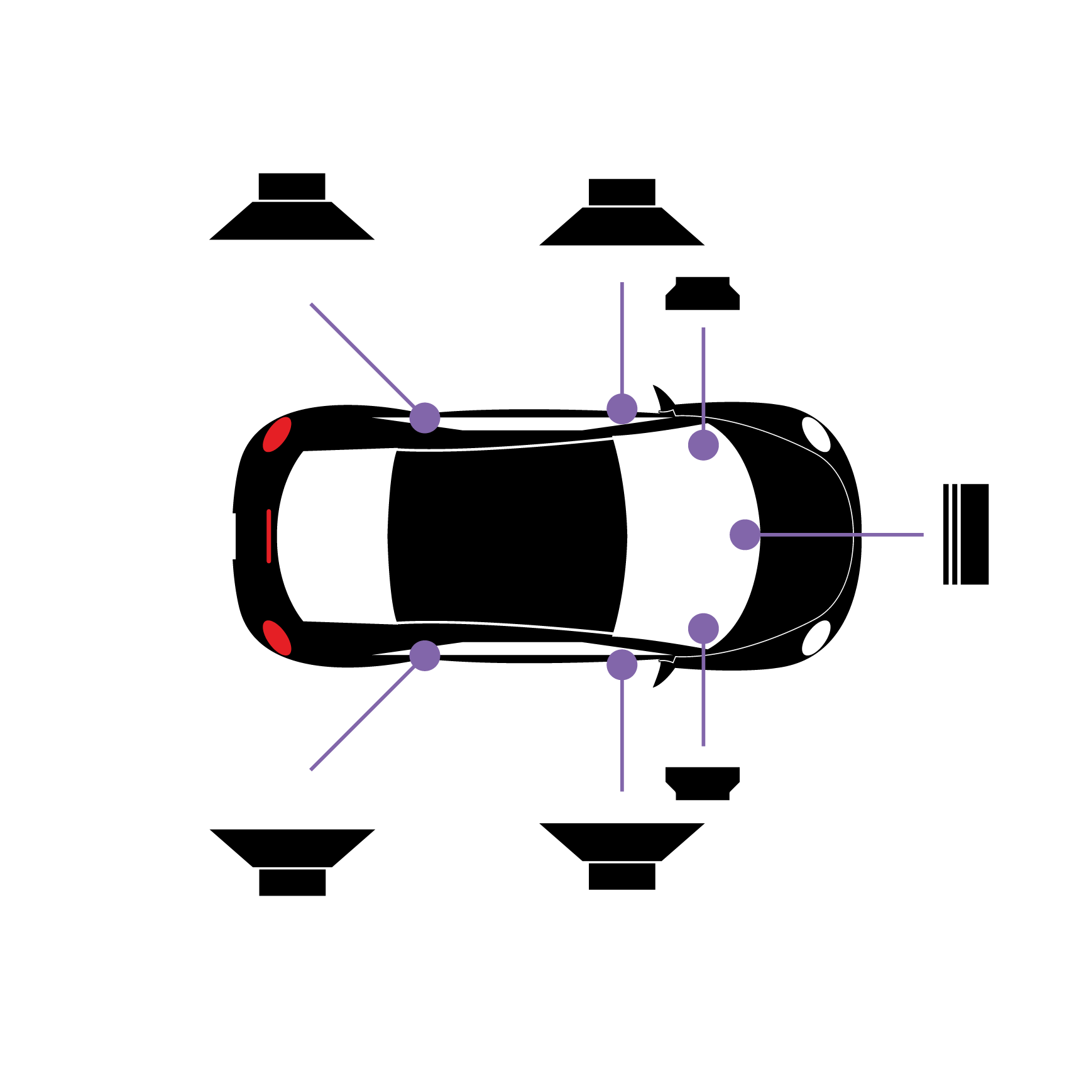
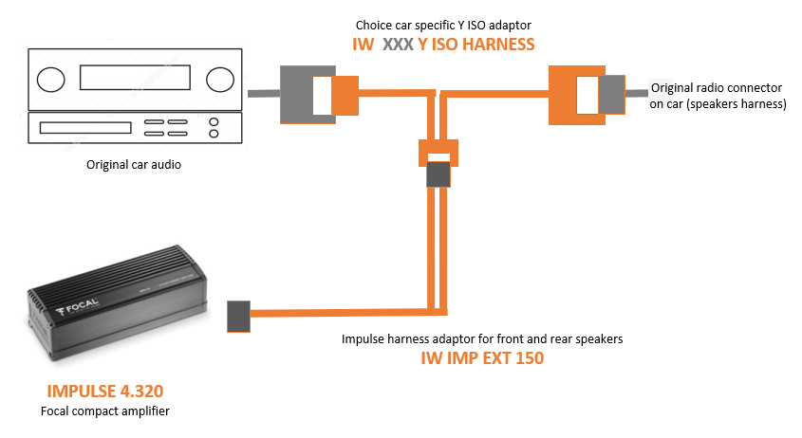
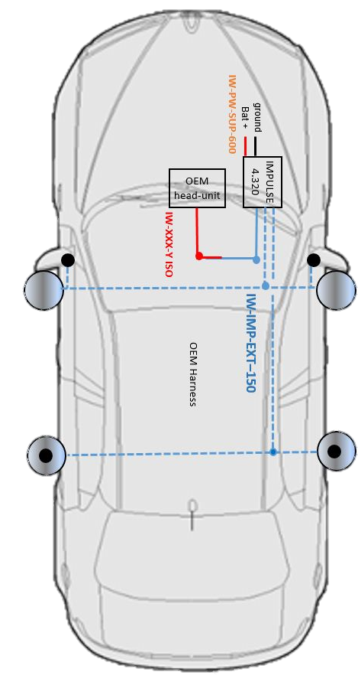
Impulse 4.320 set up Front/rear speakers
Front + Rear

Slide 3
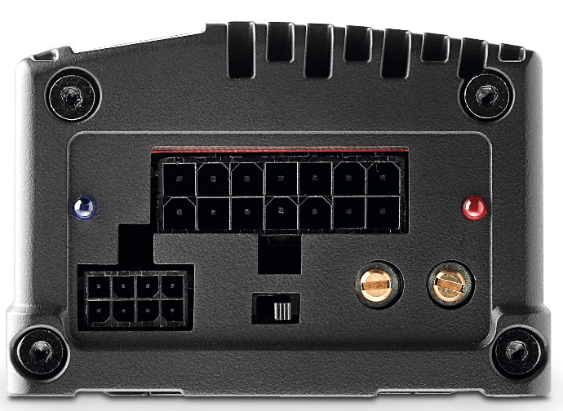
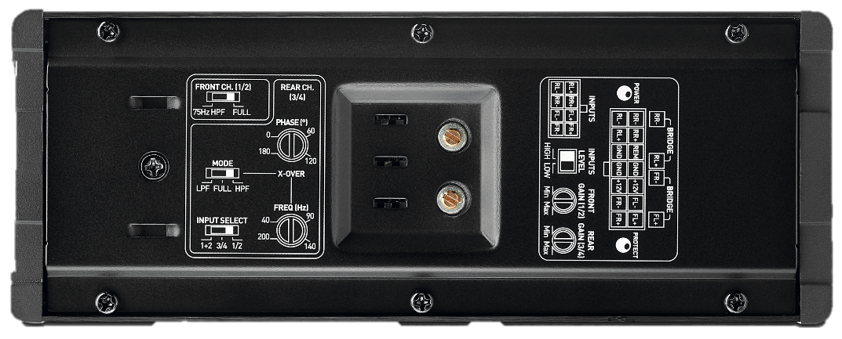
Impulse 4.320 set up Front/rear speakers
F
R
Imput level
High
Connector on the left.
Front gain*
120° position,
Increasing for more level.
Front ch (1/2)
Full Connector on the right.
Phase
0 Position
Rear gain*
120° position,
Increasing for more level.
Mode
Full Connector on the middle.
Freq (Hz)
0° Position
Input select
3/4 Connector on the middle.
Level gain*
90° maximum power level, without distortion.

Slide 4
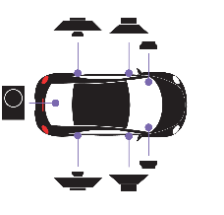
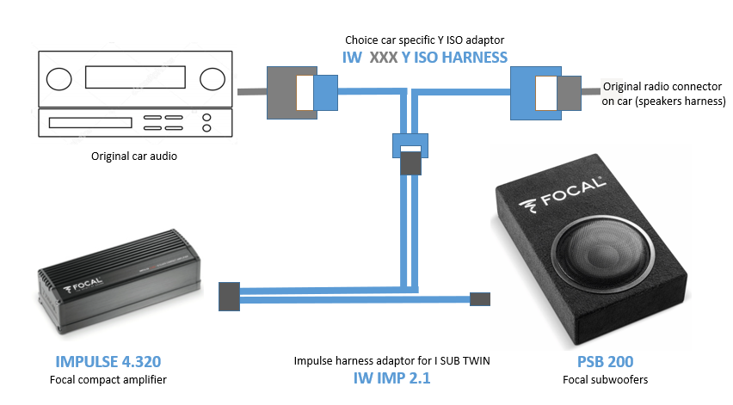
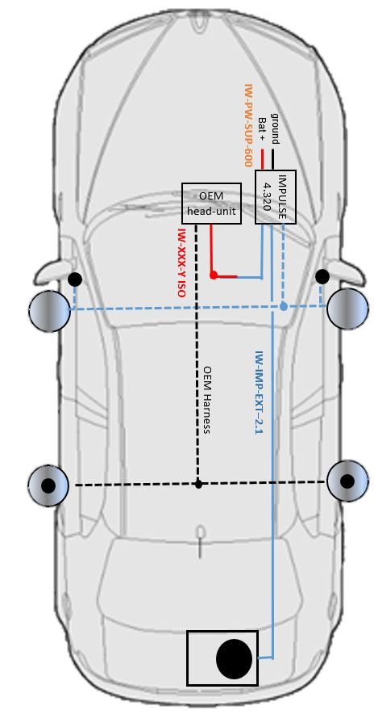
Impulse 4.320 set up with PSB 200
Front + Rear subwoofer

Slide 5
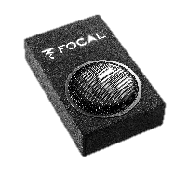
Impulse 4.320 set up with PSB 200
F
R
Imput level
High
Connector on the left.
Front gain*
180° position,
Increasing for more Med and Tw level.
Front ch (1/2)
Full Connector on the right.
Phase
0 Position
Can be adapted to match the front doors.
Mode
LPF Connector on the left.
Rear gain*
120° position,
Increasing for more bass level.
Freq (Hz)
90° Position
Can be adapted to match the front doors.
Input select
3/4 Connector on the middle.
Level gain*
90° maximum power level, without distortion

Slide 6
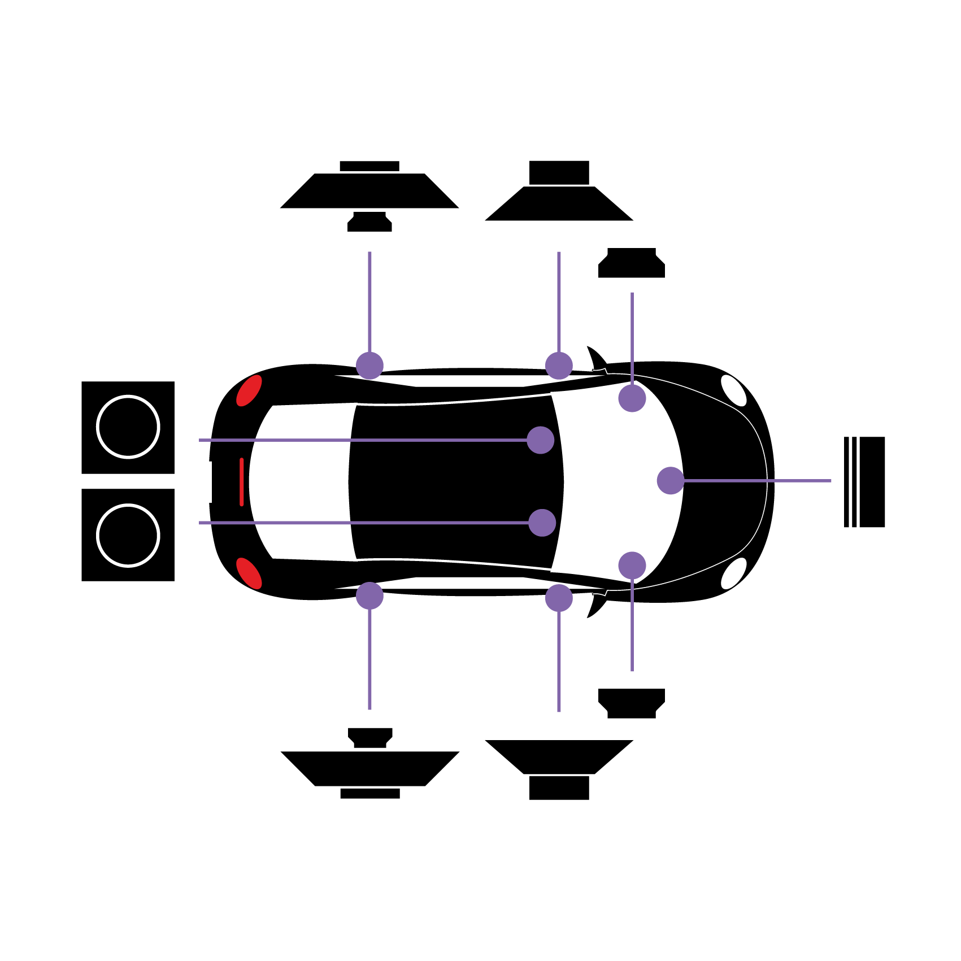
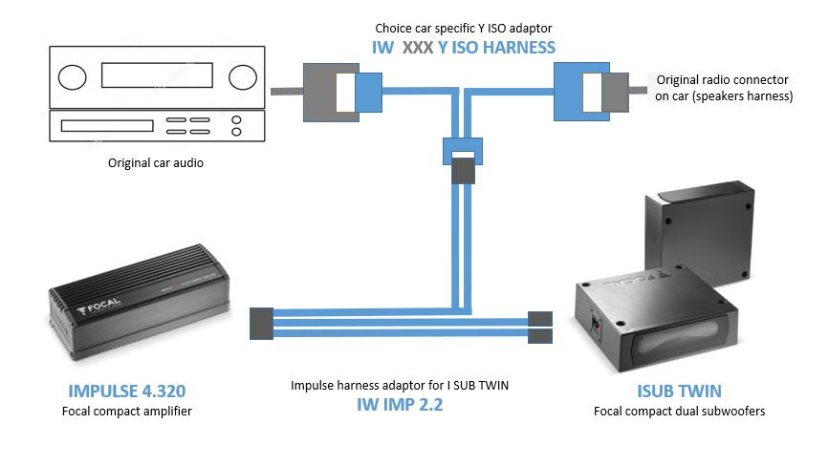
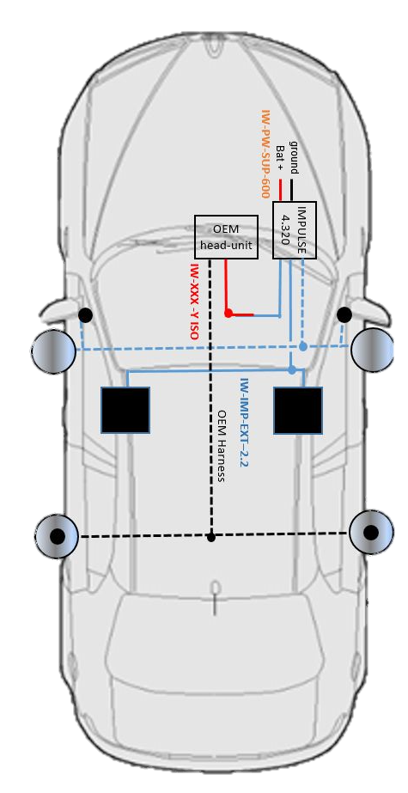
Impulse 4.320 set up with ISUB TWIN
Front + both front subwoofers

Slide 7
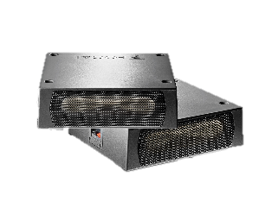
Impulse 4.320 set up with ISUB TWIN
F
R
Imput level
High
Connector on the left.
Front gain*
180° position,
Increasing for more Med and Tw level.
Front ch (1/2)
Full Connector on the right.
Phase
0 Position
Can be adapted to match the front doors.
Rear gain*
120° position,
Increasing for more bass level.
Mode
LPF Connector on the left.
Freq (Hz)
90° Position
Can be adapted to match the front doors.
Input select
3/4 Connector on the middle.
Level gain*
90° maximum power level, without distortion

Slide 8
Dedicated cables list

