Slide 1
Fast And Fit
« Cables concept »
Notes:
in a global concept idea, after the launch of our plug and play loudspeakers,
we had many requests for advice on adding amplifiers and subwoofers,
so we decided to launch the range of plug and play cables, to make it easy to install an amplifier and a subwoofer

Slide 2
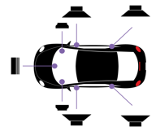
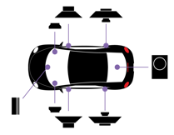
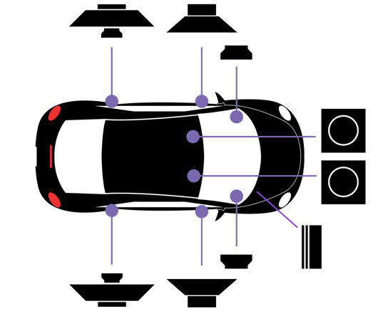
Focal Inside
IMPULSES 4.320 cables
Many audio solutions plug and play
Focal Inside audio solutions
With our line of dedicated cables for our impulse amplifier, you will find many solutions to make a complete installation.
First step :
Front and rear speakers, just replacement.
Second step :
Simply and easy to amplify with Impulse 4.320.
the front speakers and rear speakers with ampflifier
Full step :
- the front speakers with trunk sub enclosure PSB 200 with amplifier.
Or
the front speakers with the new compact sub enclosure ISUB TWIN (under seats solution).
Easy installation in plug and play, with our dedicated ISO harness cables by brands, and our cables for impulse 4.320.
Find the right references on our site www.focal-Inside.com
visit our youtube channel https://youtube.com/playlist?list=PLot2y6oPmEvuM68R6jiOi_dgeHebos2h1
Notes:
our range of cables allows you to make many audio solutions
the first step is to change the speakers
the second step is the addition of an amplifier for the front and rear
the third step is the addition of a box with either a box in the box the psb200 or our compact double box the isub twin
for each solution an extension cable is dedicated

Slide 3
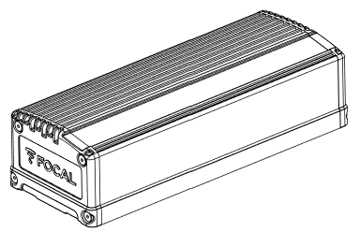
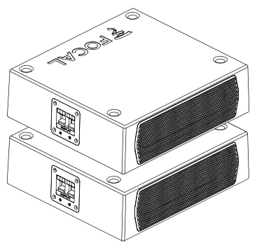
How to simply connect Focal Inside products ?
How to recover the audio signal ?
?

Slide 4
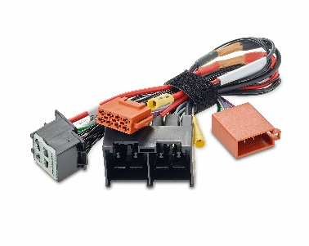
How to simply connect Focal Inside products ?
You need to choose 2 items.
1/ choose the cable harness for your car brand

Slide 5
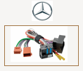
How to simply connect Focal Inside products ?
You need to choose 2 items.
1/ choose the cable harness for your car brand
We have developed 10 dedicated Y ISO harness cables
for the main car brands

Slide 6
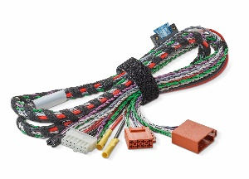
How to simply connect Focal Inside products ?
You need to choose 2 items
2/ choose the extension cable for the audio solution
you want to make to your customer

Slide 7
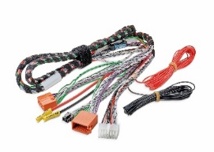
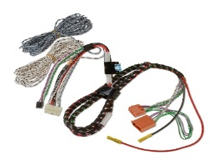
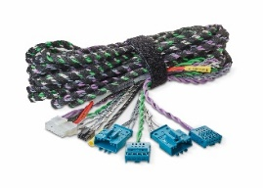
How to simply connect Focal Inside products ?
You need to choose 2 items to made a complete
focal inside audio solution
2/ choose the extension cable for the audio solution
you want to make to your customer
We have developed 4 dedicated extension cables
for each audio solution

Slide 8
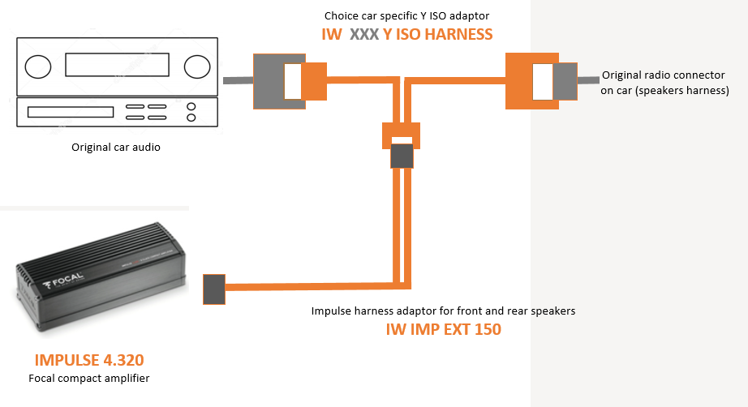
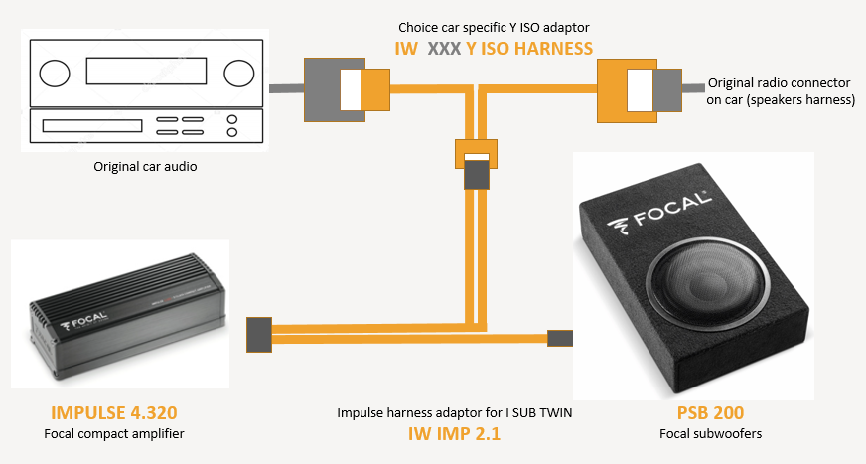
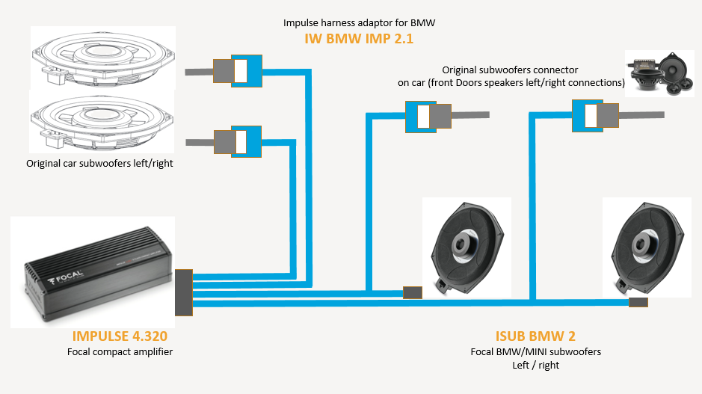
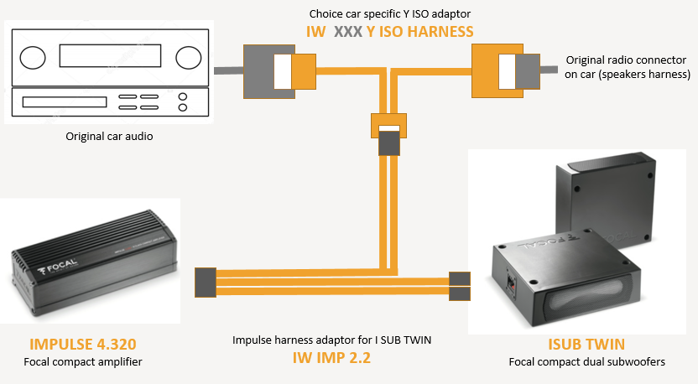
How to simply connect Focal Inside products ?
4 extensions cable for all audio solutions, and all brands
IW IMP EXT 150
IW IMP 2.1
IW BMW IMP 2.1
IW IMP 2.2

Slide 9
How to simply connect Focal Inside products ?
it's simple:
choose your car head unit Y ISO harness,
and the extension cable of the audio option you want....
Fast, easy and plug and play
Y iso harness
Dedicated for each head unit brands
Extension cable
Dedicated for each audio solution
Notes:
only one thing to remember, choose your car head unit cable dedicated to the brand of the car, and an extension cable dedicated to the audio solution you want to make for your customer
this type of audio solution works with plug and Focal inside loudspeakers, but also with other Focal loudspeaker lines, it is not exclusive

Slide 10
Fast And Fit
« Dedicated cables workshop detail»
Notes:
in a global concept idea, after the launch of our plug and play loudspeakers,
we had many requests for advice on adding amplifiers and subwoofers,
so we decided to launch the range of plug and play cables, to make it easy to install an amplifier and a subwoofer

Slide 11
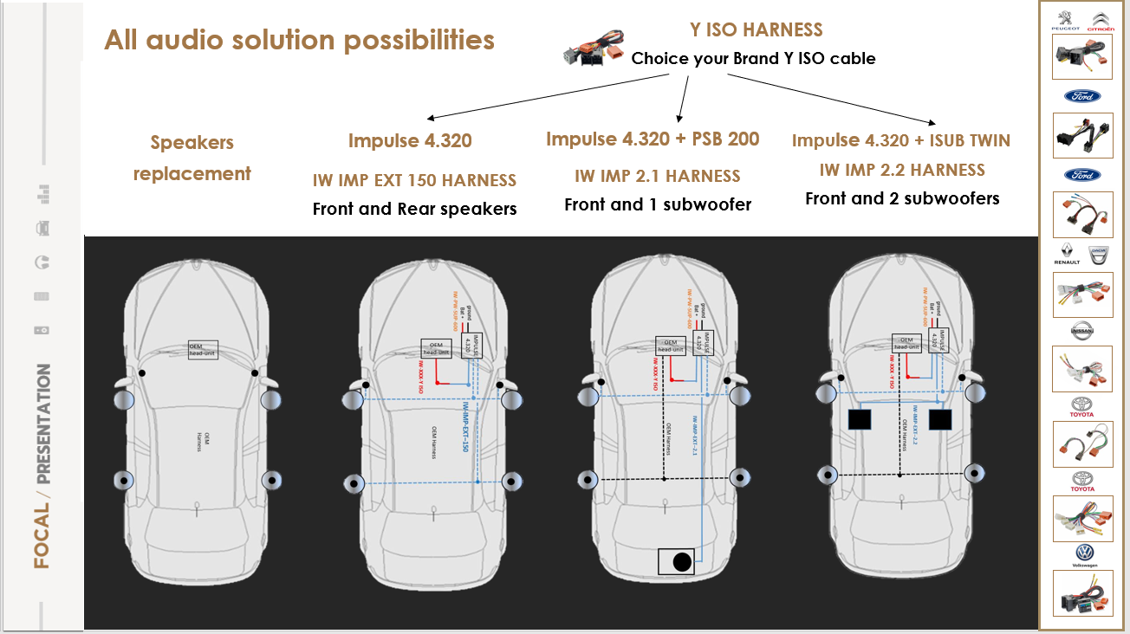

Slide 12
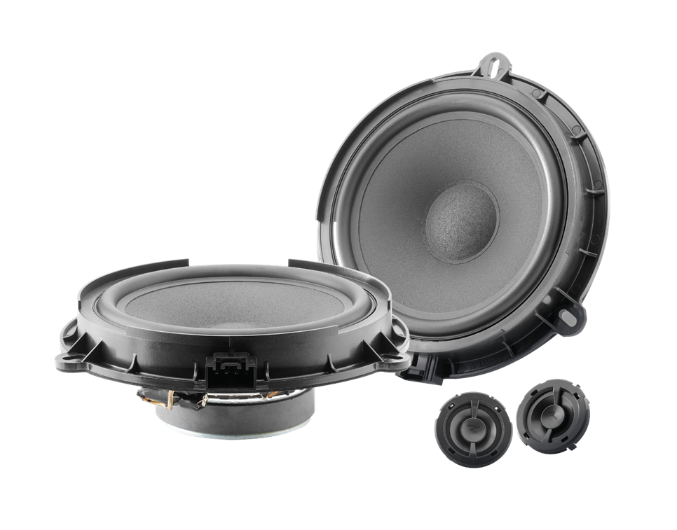
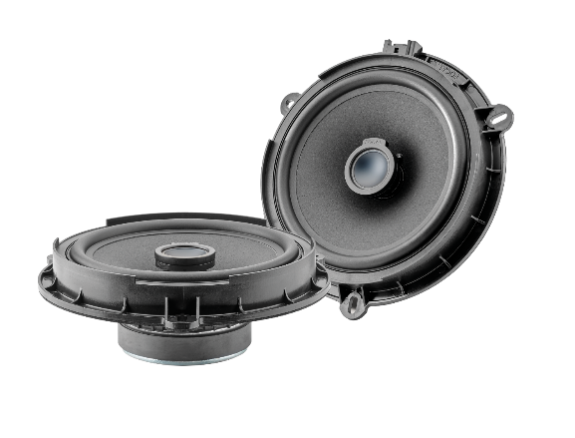
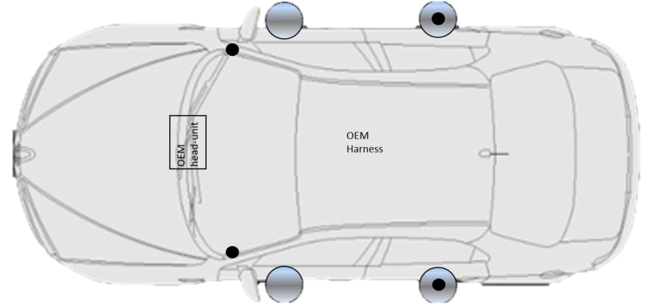
SET-UP 1 Speakers replacement
+
DEDICATED INTEGRATION CABLES
IS XXX 165
IC XXX 165
Choice your right reference and brands on www.focal-inside.com
Notes:
step 1 we change the speaker, plug and play,
to help you you have our focal site inside, and the table of compatible cars which is updated every month.
Nothing modficated, nothing cut the Focal inside products are real 100% plus and play
for fast business

Slide 14
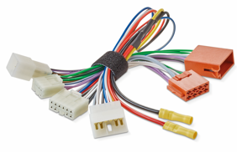
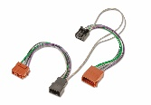
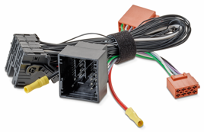
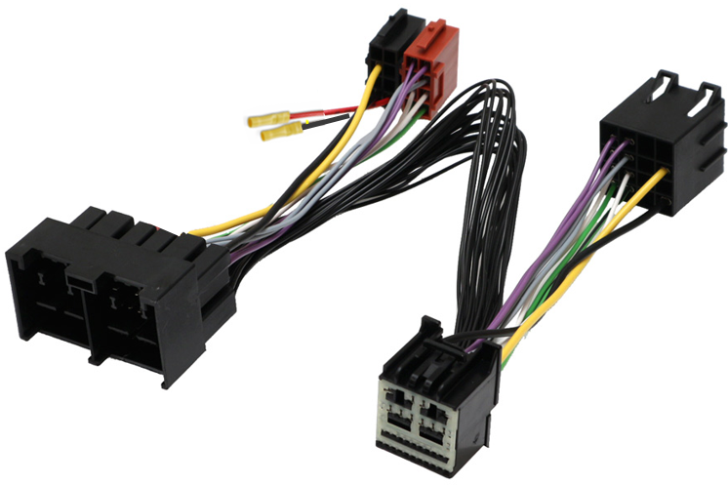
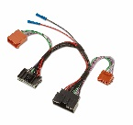
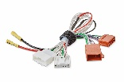
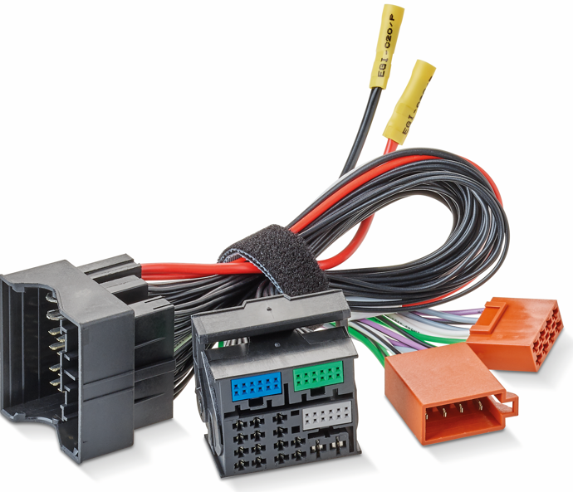
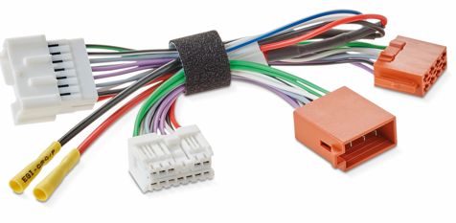
Cable explication
IW IMP EXT 150
It is very easy to upgrade the sound of your car, from the original car radio.
Have installed a cable behind the car radio on the original connectors.
Our Y ISO Harness adaptor sends the audio signal to our dedicated cable of the chosen audio solution.
Direct plug play on the Impulse 4.320 amplifier and amplify front and rear speakers.
it remains to connect a Ground and the power supply and the installation is ready.
Choice the harness référence on Focal Inside compatibility list
Focal Head unit
Harness solution
Y iso cables
Notes:
Diagram for this cable iw imp ext 150

Slide 15
Notes:
Cable details iw imp ext 150

Slide 17
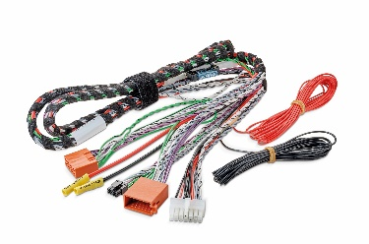
Cable explication
IW IMP 2.1
It is very easy to upgrade the sound of your car, from the original car radio.
Have installed a cable behind the car radio on the original connectors.
Our Y ISO Harness adaptor sends the audio signal to our dedicated cable of the chosen audio solution.
Direct plug play on the Impulse 4.320 amplifier and on sub boxes PSB200.
Direct bridge subwoofer mode.
It remains to connect a Ground and the power supply and the installation is ready.
Choice the harness référence on Focal Inside compatibility list
Focal Head unit
Harness solution
Y iso cables
Notes:
Diagram for this cable iw imp 2.1

Slide 18
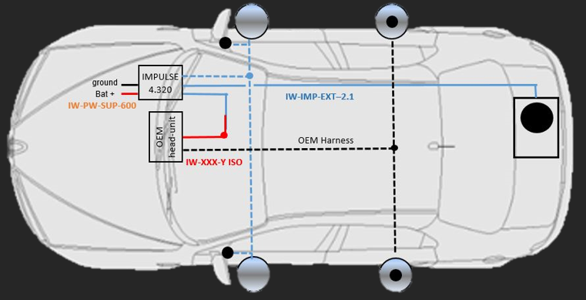
IW IMP 2.1
Cable explication
Fuse protection
Output speakers bridge mode to PSB 200
OEM cable protection
Input speakers
Iso connector
Direct plug to Focal Y ISO harness
Direct Input connector to impulse
Output speakers
Notes:
Cable details iw imp 2,1

Slide 20
Cable explication
IW IMP 2.2
It is very easy to upgrade the sound of your car, from the original car radio.
Have installed a cable behind the car radio on the original connectors.
our Y ISO Harness adaptor sends the audio signal to our dedicated cable of the chosen audio solution.
Direct plug play on the Impulse 4.320 amplifier and on the two twin sub boxes with IW IMP 2.2 cable.
it remains to connect a Ground and the power supply and the installation is ready.
Choice the harness référence on Focal Inside compatibility list
Focal Head unit
Harness solution
Y iso cables
Notes:
Diagram for this cable iw imp 2.2

Slide 21
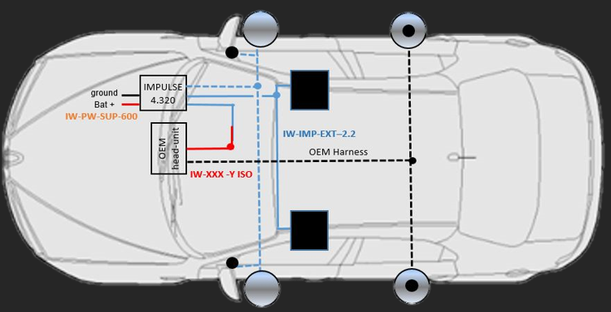
Cable explication
IW IMP 2.2
Output speakers to ISUB TWIN (left/right)
Fuse protection
OEM cable protection
Input speakers
Iso connector
Direct plug to Focal Y ISO harness
Output speakers
Direct Input connector to impulse
Notes:
Cable details iw imp 2.2

Slide 22
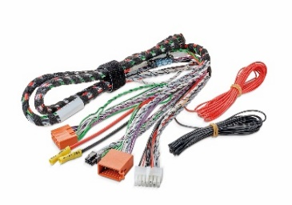
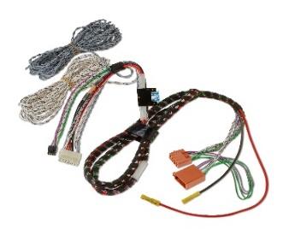
Focal Inside cables references main brands
Head unit y iso harness adaptor
Impulse cable extension
IW FOR YISO HARNESS
IW FOR YISO HARNESS V2
IW IMP ext 150 (2.0)
IW NIS YISO HARNESS
IW TOY YISO HARNESS
IW IMP 2.1
IW TOY YISO HARNESS V2
IW VW YISO HARNESS
IW IMP 2.2
Notes:
Many cable but really simple to understand the concept

Slide 23
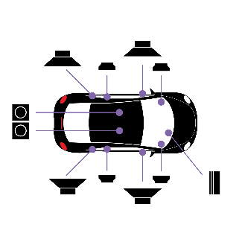
Mercedes
Focal Inside IW IMP 2.2 cables
Audio solution plug and play
Mercedes cable, Front speaker and both front subwoofers audio amplification.
Easy audio solution
With our line of dedicated cables made for our impulse 4.320 amplifier, you will find many solutions to make a complete audio installation.
New Focal Inside cable IW BMW IMP 2.2 can fit on Mercedes, You have the possibility to
add impulse 4.320 amplifier and two front subwoofers, fast and easily.
(ONLY available with NGT 5 head unit, not after)
Easy installation in plug and play, just connect our Y ISO fakra and IW IMP 2,2 cables to subwoofer with Mercedes connector (included on box).
You can amplify front doors speakers, and both under seat subwoofers…. Simple

Slide 24
Control the harness référence on Focal Inside compatibility List, Word Only with NGT5 Mercedes head unit, before 06/2019
Notes:
Mercedes solution
after changing the loudspeaker, we add a compact amplifier, and TWO front subwoofers
the impulse 4.320 2 channels for front 2 channels for both front subwoofers I SUB MBZ 2
the cables that we then need is a y iso harness dedicated to the brand of the car. fakra or quadlock,
this plug and play cable allows you to easily retrieve the audio signal from the car radio.
to this we will connect an extension cable to it, the "iw imp 2.2” extension cable which connects between the ISO harness of the car radio and directly on the impulse. With two cables to connect to each subwoofers
this assembly can be done on all cars, just take the ISO harness dedicated to the brand.
Warning: this solution fit only with NGT 5 head unit, not after

Slide 25
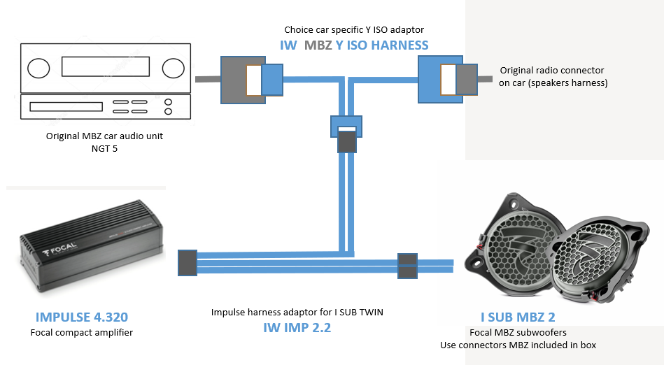
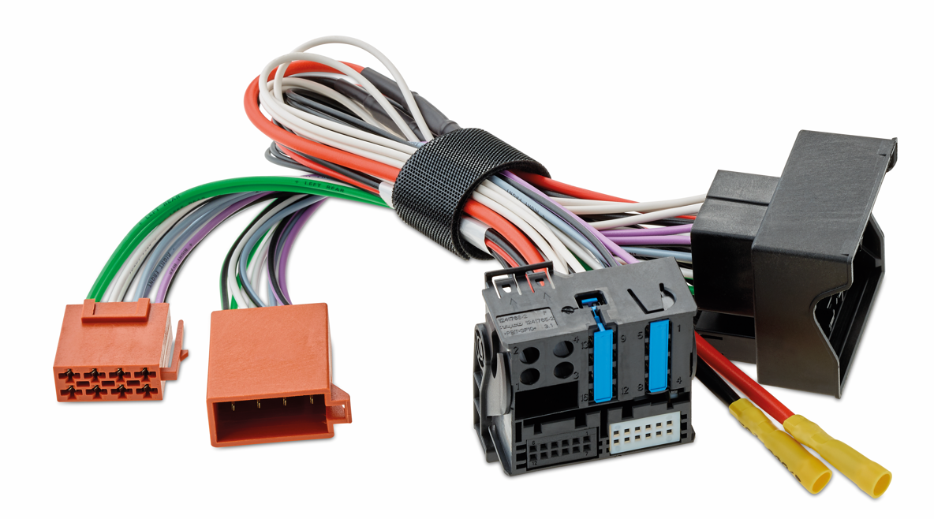
Cable explication
IW IMP 2.2
Control the harness référence on Focal Inside compatibility List, Word Only with NGT5 Mercedes head unit, before 06/2019
It is very easy to upgrade the sound of your car, from the original car radio.
Have installed a cable behind the car radio on the original connectors.
our Y ISO Harness adaptor sends the audio signal to our dedicated cable of the chosen audio solution.
Direct plug play on the Impulse 4.320 amplifier and on the two twin sub boxes with IW IMP 2.2 cable.
it remains to connect a Ground and the power supply and the installation is ready.
Focal Head unit
Harness solution
Y iso cables
Notes:
Diagram used

Slide 26
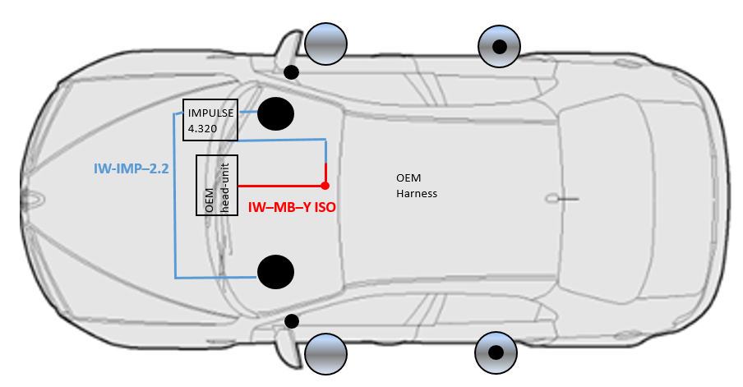
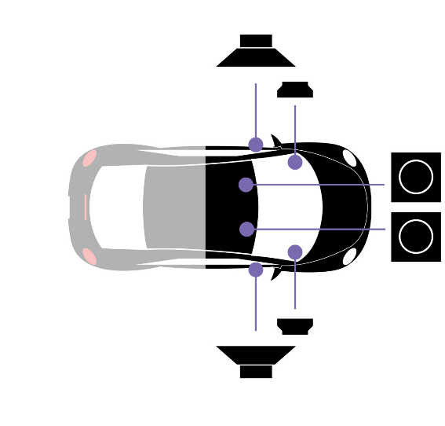
EXTENSION CABLE IW IMP 2.2
IW – IMP – 2.2
Extension cables IMPULSE 4.320
Connect the head-unit harness with ISO connector, in Amplifier IMPULSE 4.320 with specific connectors.
With the iso connector we recover the signal at the iso output of the car head unit, and after amplifying it we send it back to the front speakers using the original car harness. 2 rear channel Impulse can manage 2 front subwoofers, better with 2ohms speakers.
This cable simply the impulse connection in each car. The IMPULSE 4.320 amplifier allows you to amplify the front speakers and front subwoofers
2x50w front 2 x80w rms 2ohms subwoofers. If the power supply allows you to directly connect the impulse to the dedicated connectors of the Focal Y ISO harness. The search for position and ground power is then completely simplified.
2 x Subwoofer cable to connect
2 front subwoofers
Fuse protection
OEM cable protection
Input speakers
to impulse
Ground supply
connection
Output speakers to impulse direct iso car Harness

Slide 27
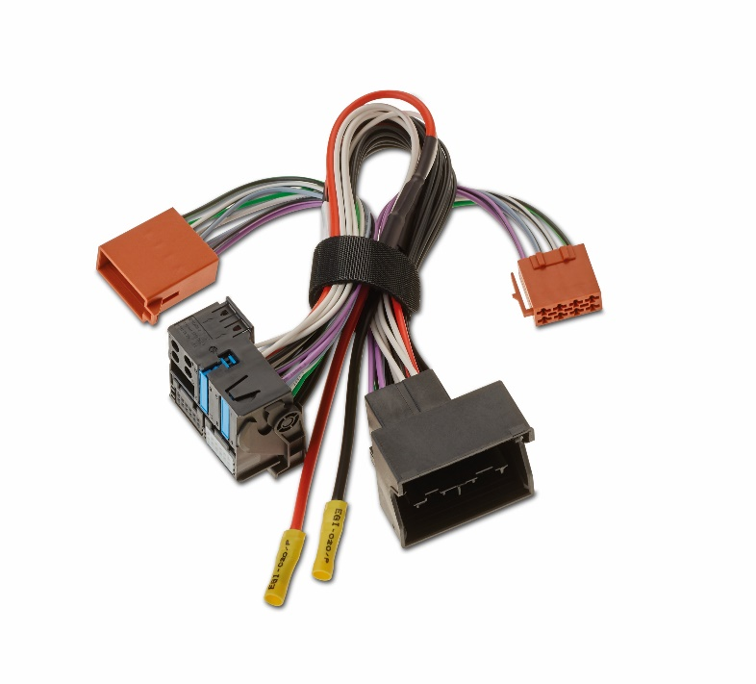
Mercedes Warning
IW MBZ Y ISO
HARNESS
Notes:
Warning for use this solution only with NGT5 radio, they used fakra connect
The new system after 2020 use QUADlock connector, and a second connector only for manage both front subwoofers.

Slide 28
BMW / MINI
Focal Inside IW BMW IMP 2.1 cables
Audio solution plug and play
BMW cable, Front speaker and both subwoofers under seat audio amplification.
Easy audio solution
With our line of dedicated cables made for our impulse 4.320 amplifier, you will find many solutions to make a complete audio installation.
New Focal Inside cable IW BMW IMP 2.1 dedicated to BMW/MINI, You have the possibility to
add impulse 4.320 amplifier and two under seat subwoofers, fast and easily.
No need to remove head unit.
(Not available with GPS pro, top Hifi and Harman Kardon option)
Easy installation in plug and play, just connect our Y cables to subwoofer with BMW connector.
and you can amplify front doors speakers, and both under seat subwoofers…. Simple

Slide 29
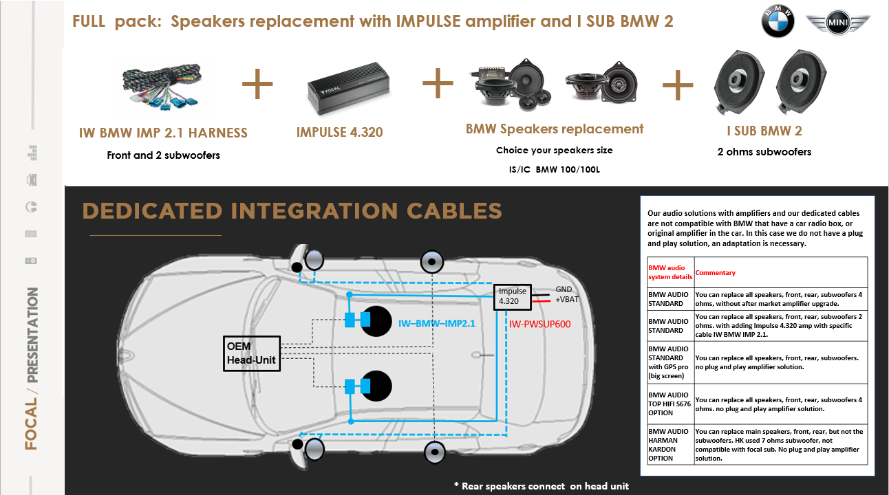

Slide 30
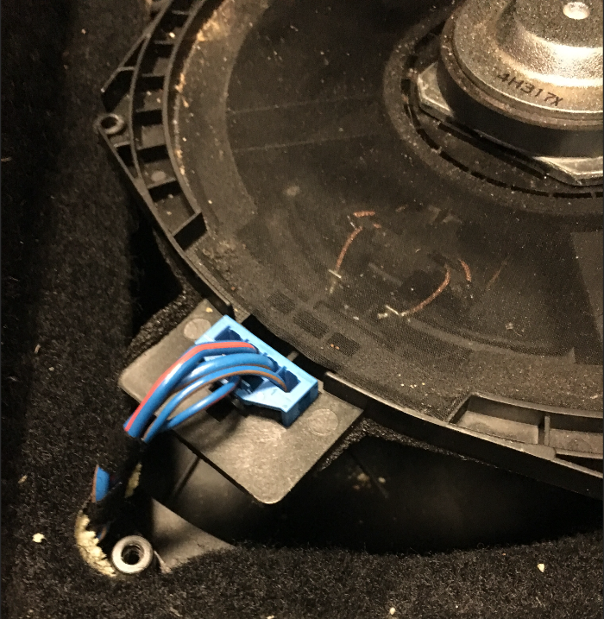
Cable explication
IW BMW IMP 2.1
On standard BMW audio versions, the audio signal from the front doors is parallel to the front subwoofers.
The audio signal coming out of the car radio goes through the subwoofers under the seats to go into the doors.
Our IW BMW IMP 2.1 focal cable allows to recover the signal on this BMW sub connectors, left and right.
Direct to amplify it with our impulse 4.320.
to separate it, 2 channels for the front doors, and two channels for the two subwoofers left and right.
With the settings of the impulse, this will give you an extraordinary update, and simply without disassembling the car radio.
This cable is compatible with cars with 4 wires in the subwoofer connectors under the seats.
Notes:
Diagram used
to know if this cable can be mounted or not, just look if there are 4 cables on the subwoofer connector.if there are only 2, there is an amplifier on the car (trunk on the left)

Slide 31
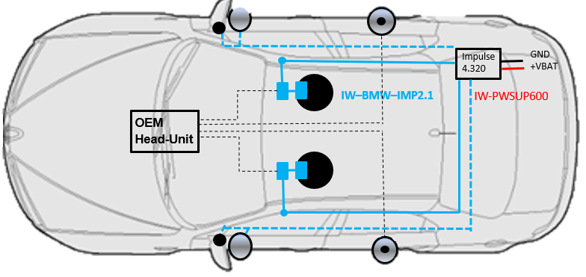
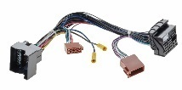
Cable explication
IW BMW IMP 2.1
OEM cable protection
Fuse protection
Output subwoofers
speakers left and right
Direct Input connector to impulse
BMW connectors audio signal in/out for front speakers
Focal Head unit
Harness solution
Y iso cables for other update

Slide 32
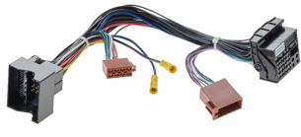
Focal Inside cables references
Head unit y iso harness adaptor
Impulse cable extension
IW BMW YISO HARNESS
IW FOR YISO HARNESS
IW BMW IMP 2.1
IW FOR YISO HARNESS V2
IW NIS YISO HARNESS
IW IMP ext 150 (2.0)
IW MBZ YISO HARNESS
IW PSA YISO HARNESS
IW REN YISO HARNESS
IW IMP 2.1
IW TOY YISO HARNESS
IW TOY YISO HARNESS V2
IW IMP 2.2
IW VW YISO HARNESS
Notes:
we have also developed a fakra car radio connector for bmw and mini, in case you want to make more extensive installations, with dsp, amplifiers etc.

